Slide 1






August 18th, 2020
PM: Hunter
Frontend: Hunter, Annie, Neha, Jason Pu, Andrew E, Andrew F, Sam S, Shweta
Backend: Hunter
Notes:
Presenter: Hunter
Hello everyone! We are Poll Buddy. I’m Hunter, the project manager, and I’m going to start us off by giving an overview of our app and how we’re developing it, and later you’ll hear from the other Poll Buddies some in depth details relating to the different portions of the project. We do have the presentation separated into overview, frontend, and backend, but the bulk of the presentation time will be spent on Frontend as that was our main focus this semester.

Slide 2

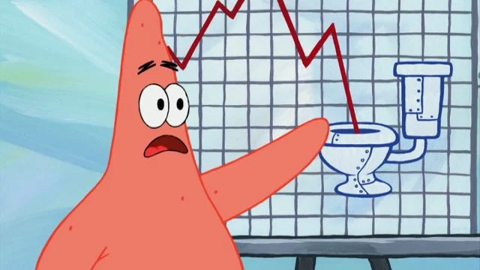
What is Poll Buddy?
Website alternative to iClickers
“Virtual Classroom”
Affordable, easy-to-use, and interactive
Customizable teacher and student views
Integratable with Submitty and other RPI platforms
Notes:
Presenter: Hunter
So what is Poll Buddy? Poll Buddy is basically a website alternative to iClickers. iClickers are classroom tools used to get responses from students, but they have some major limitations. We want to build a virtual classroom system that’s affordable, easy to use, and interactive that offers customizable views for both teachers and students. We also aim to integrate with other RPI platforms like Submitty and CAS for things like easy automatic grading and simple sign in.

Slide 3
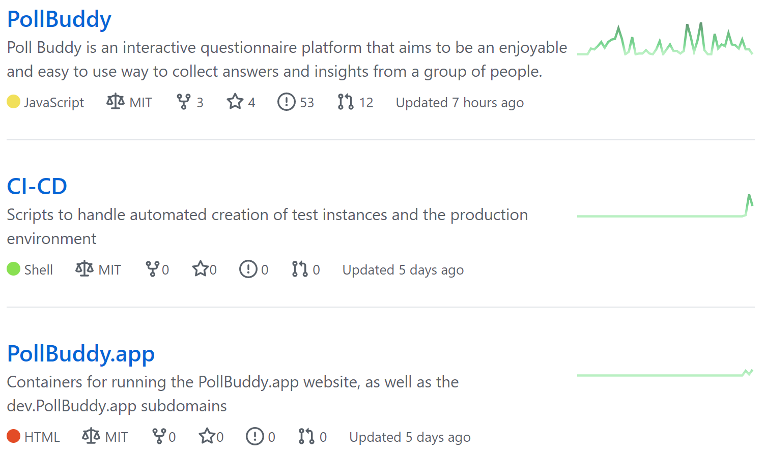
PollBuddy Info
Time goal of the project: minimum viable product by next semester
Repos: https://github.com/PollBuddy
Licenses: MIT
Contributors: Anyone can access the GDrive folder of resources from the main repo. Github issue list gives potential tasks to work on. Readme file(s) expansions and contributing guides planned.
Notes:
Presenter: Hunter
We’re hoping to have this ready for trial runs in RCOS next semester (similar to how Venue is being used now), and use feedback from that to finish preparations for a wider rollout. Given that Arch is a shorter semester, we didn’t get as far as we’d hoped but we did still make a ton of progress and are finally just about ready to get the first testers on the platform.
On this slide, I’ve linked our Github Organization page that contains the 3 repos we now have, and what license they use. As for contributors, anyone is able to access our Google Drive folder with project resources, Github issues give an easy way to find something to do, and in the near future we’ll be expanding our documentation through more thorough readmes and contribution guides.

Slide 4
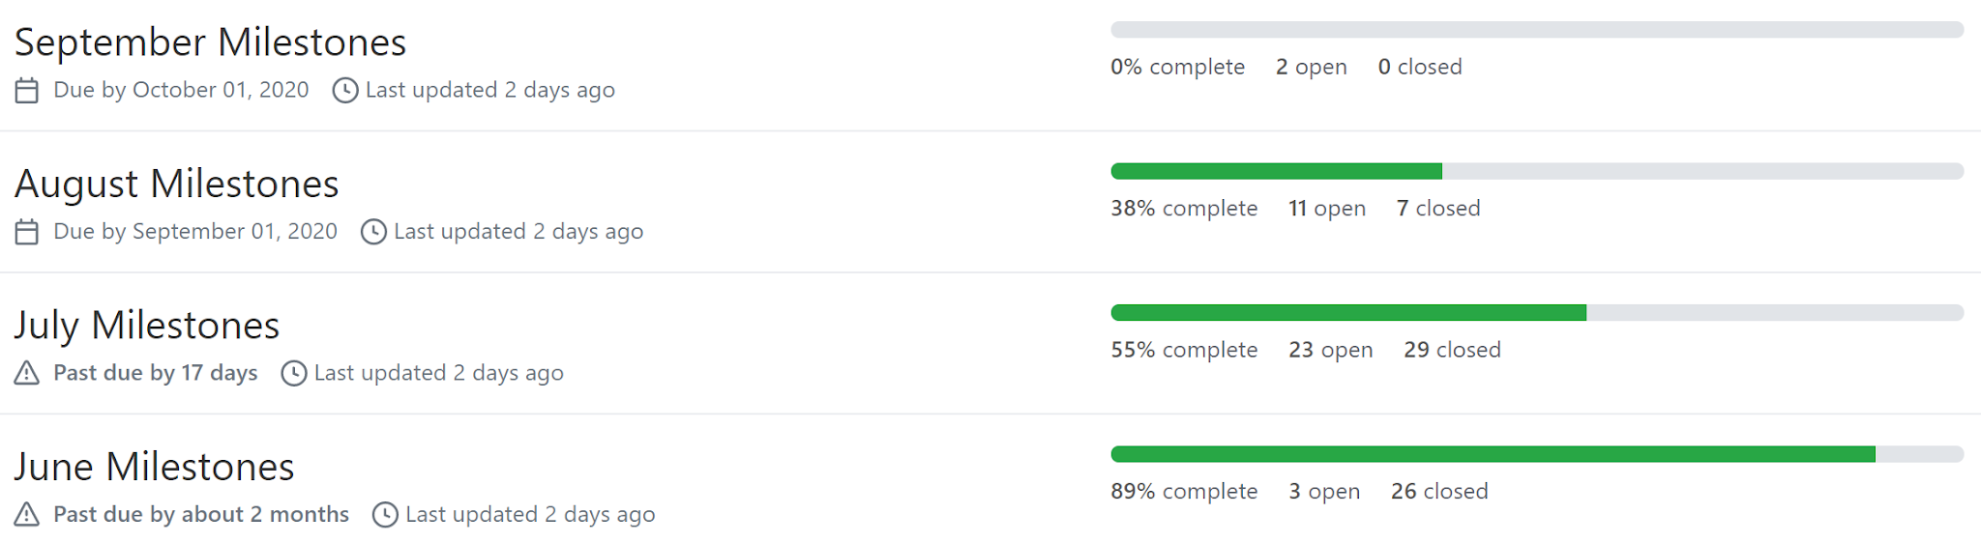
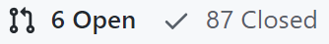
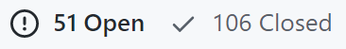
Managing the Project
Milestones were broken down into months and issues per month.
Issues used as trackers for todo items. Labeled frontend/backend/other as relevant.
Notes:
Presenter: Hunter
We use a simple system of tracking to-do items through Github Issues, and linking them to Milestones to group them by month to keep on a schedule. This is a plan we put into place last semester, and has been very helpful to manage the project. We don’t always meet all the “deadlines” as you can see from the lower right image, but that’s okay as some stuff just takes longer and it helps enable people to work on what they want to work on more while still getting everything done eventually. I do expect this to occur less though as more and more of the app gets complete and certain issues become more important with actual users.

Slide 5
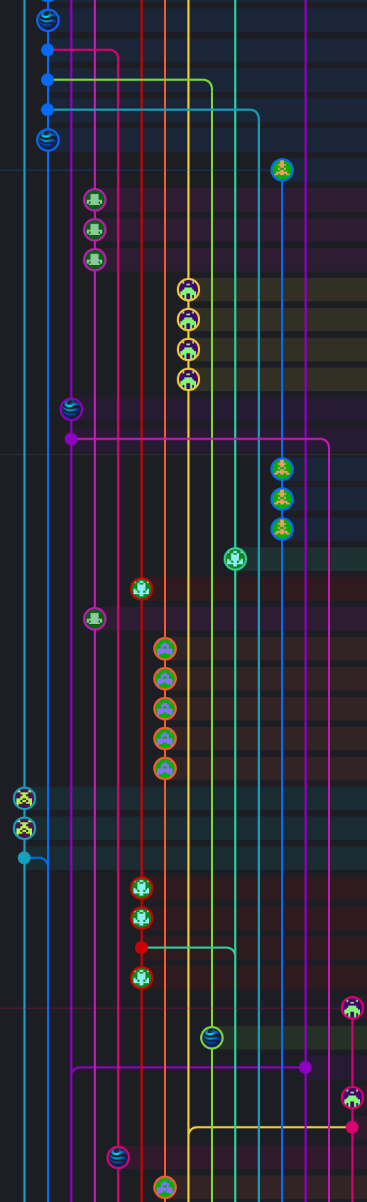
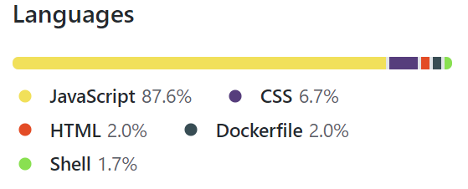
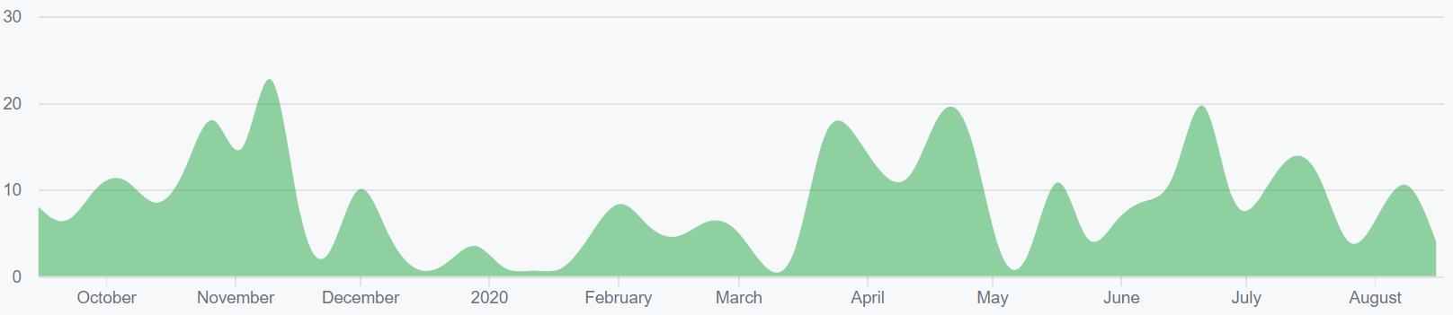
Repo Stats
568 total commits to master (as of 8/18/20)
Contributions to master, excluding merge commits:
Notes:
Presenter: Hunter
Here are some basic stats about the repo. We’ve had a fantastic amount of commits this semester, more than doubling our commit numbers of about 250 total from all previous semesters combined to well over 500 now. If we include commits in pull requests waiting to be merged, and the new repos, we’re well past 600. The previous semester was mostly focused on design, so now it was very easy this semester to focus on just implementing everything we planned out already.

Slide 6
Front End
Notes:
Hunter: And now I’d like to pass it off to Neha to talk about the frontend.
Presenter: Neha
Hi I’m Neha and I was part of the frontend team this semester.

Slide 7

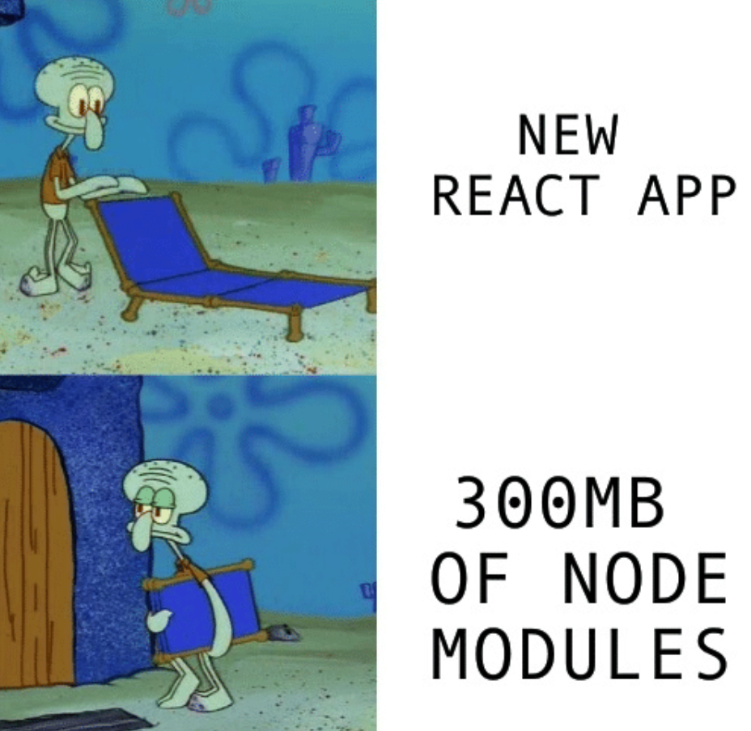

Frontend Framework
REACT!
Notes:
Presenter: Neha
We use React as the framework for Poll Buddy because it allows for efficient code reuse. We also decided to use MDBReact which is a library of pre made components like buttons and graphs which look really nice and save us work on css styling

Slide 8

Frontend Tasks
Completed:
New sitemap diagram and URL scheme
CSS Unification
Code quality fixes
Page styling refinement and consistency fixes
Accessibility tweaks
In Progress:
Backend integration
More dynamic functionality
Creating all pages defined in the initial sitemap and design slides
Poll
Buddy
Everything else
Notes:
Presenter: Neha
This semester, we had a bunch of goals to accomplish for the frontend. We managed to complete the first five tasks over the summer, but the last three, especially backend integration, still need a bit more work.

Slide 9
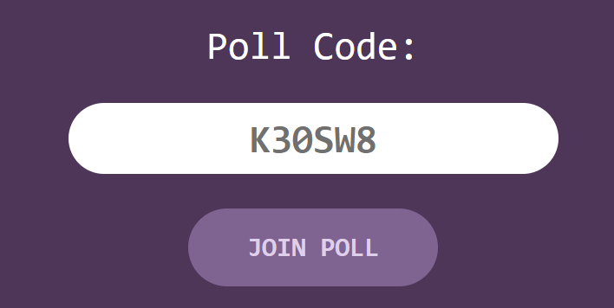
Unified Stylesheet
Consistent style
Easy to change
Less repeated code
Notes:
Presenter: Neha
The first thing I personally did was create a unified stylesheet for the frontend of our website. Having a main css file was overdue for us. There are many advantages to having a main css file: it makes the style of the website consistent, it's easy to make any styling changes for all the pages, and there's less repeated code throughout the website

Slide 10
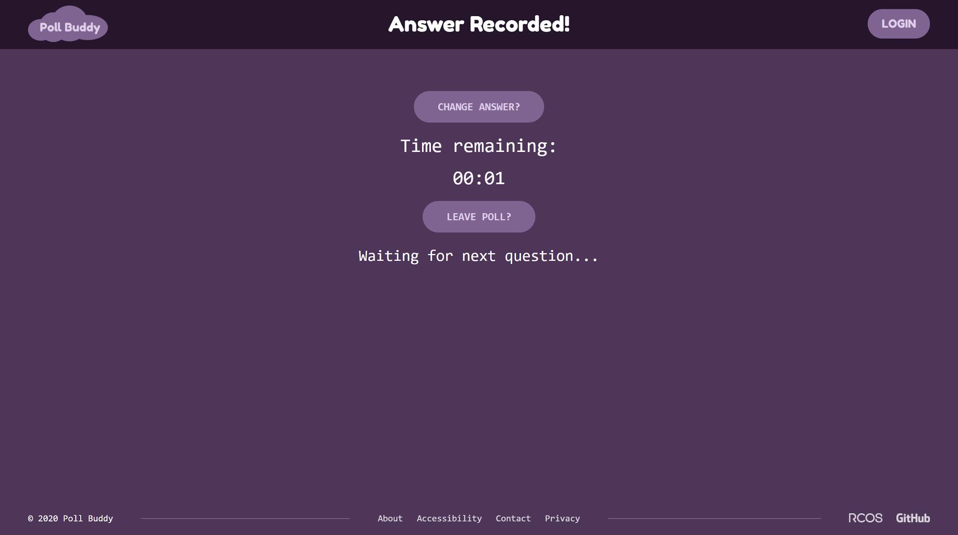
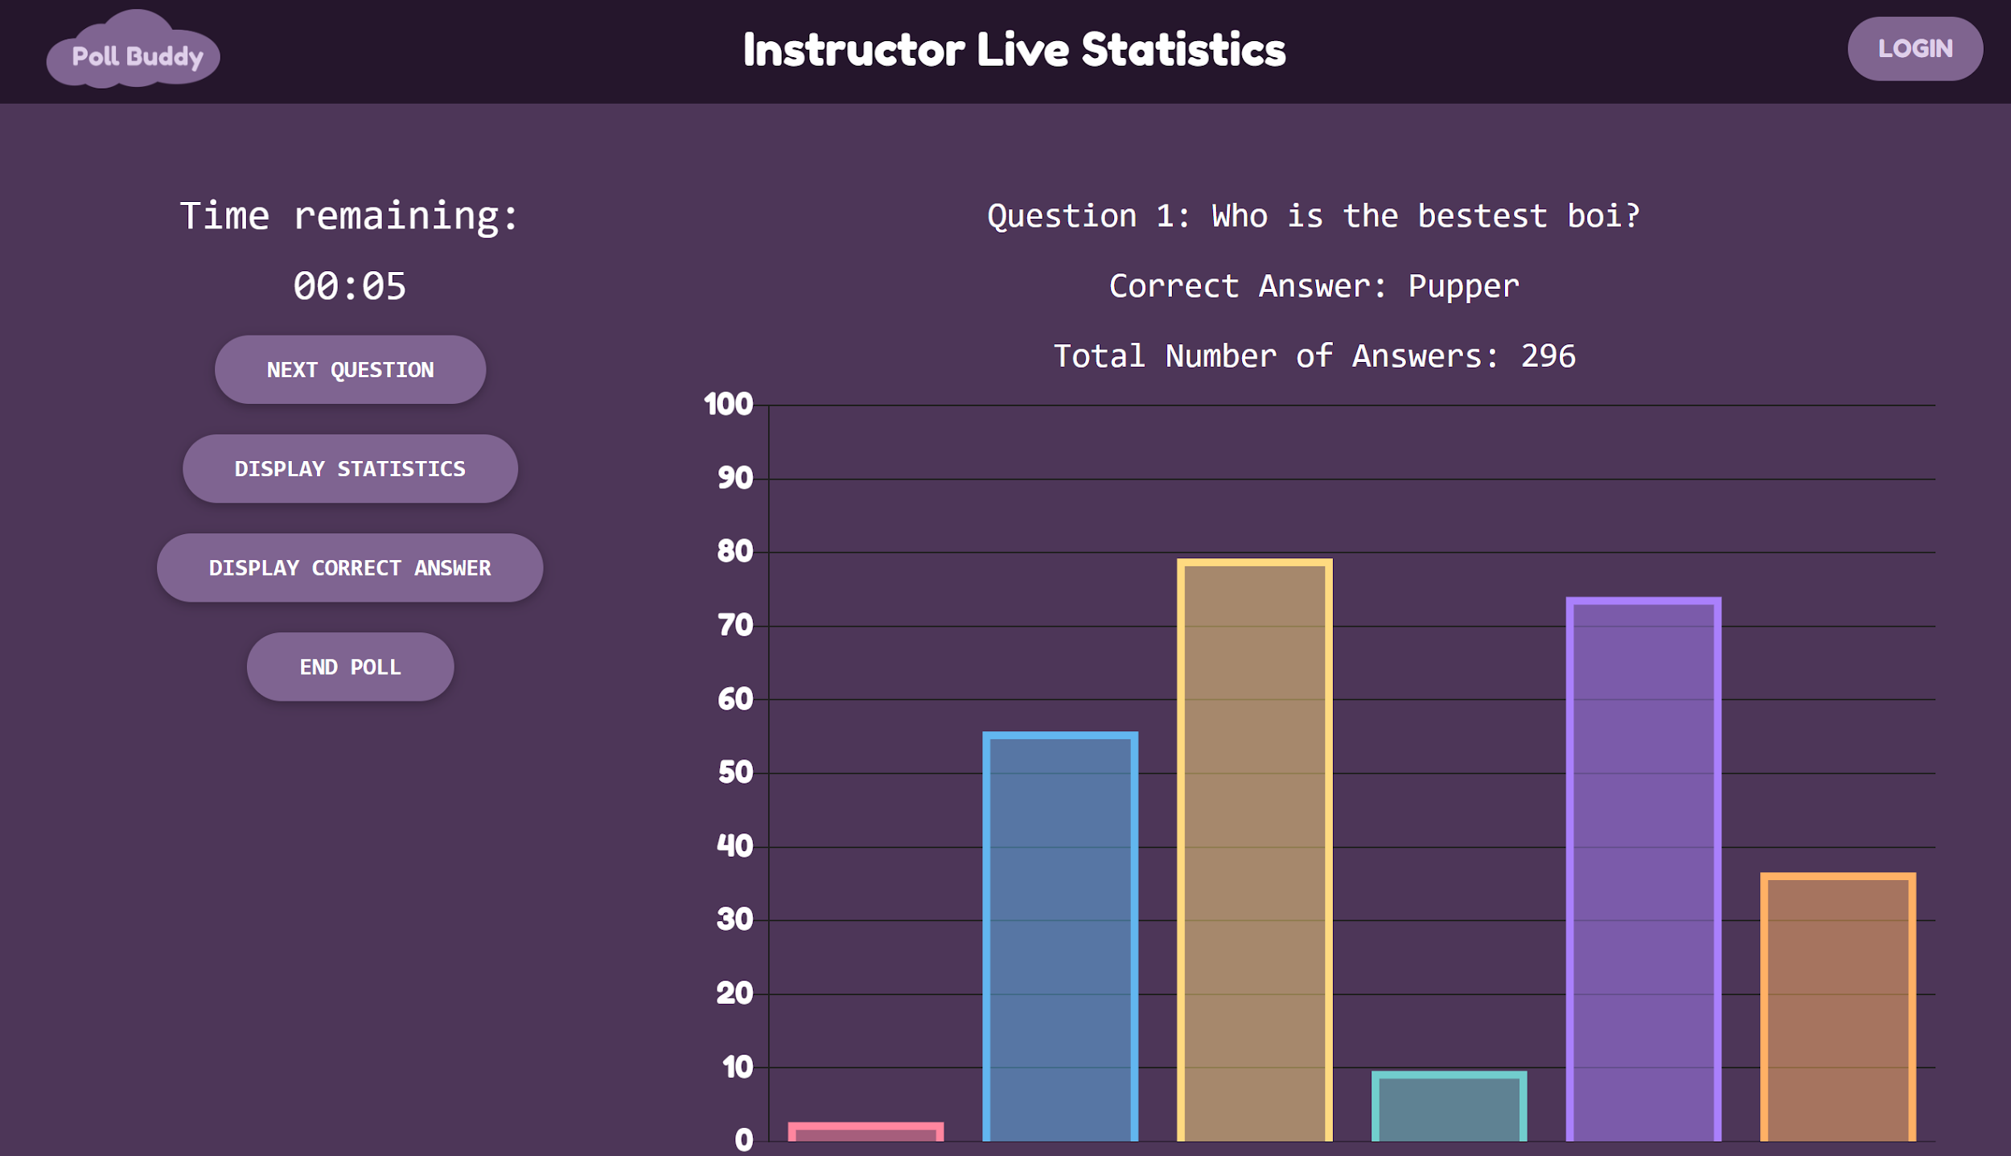
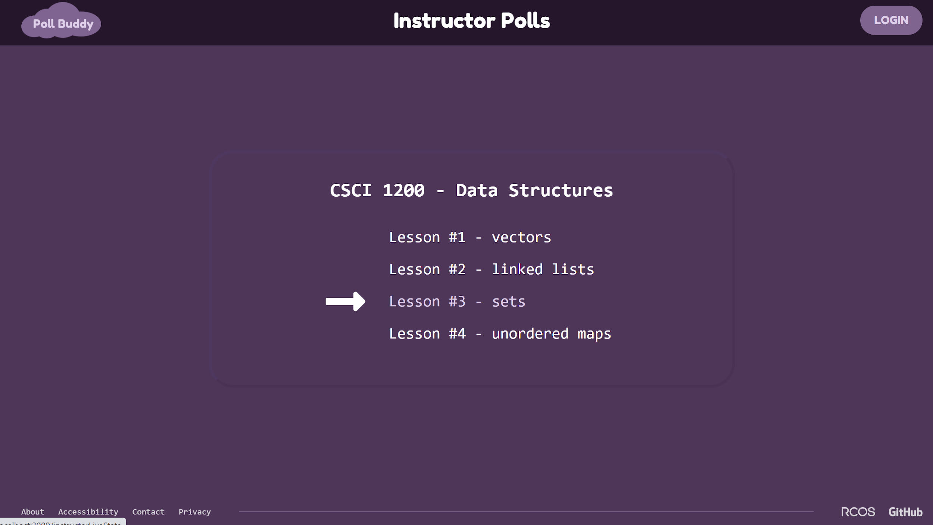
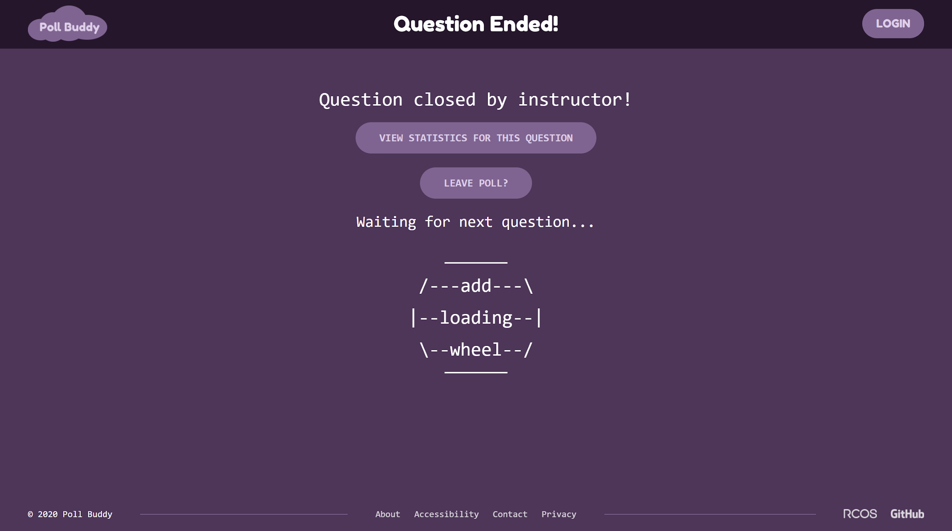
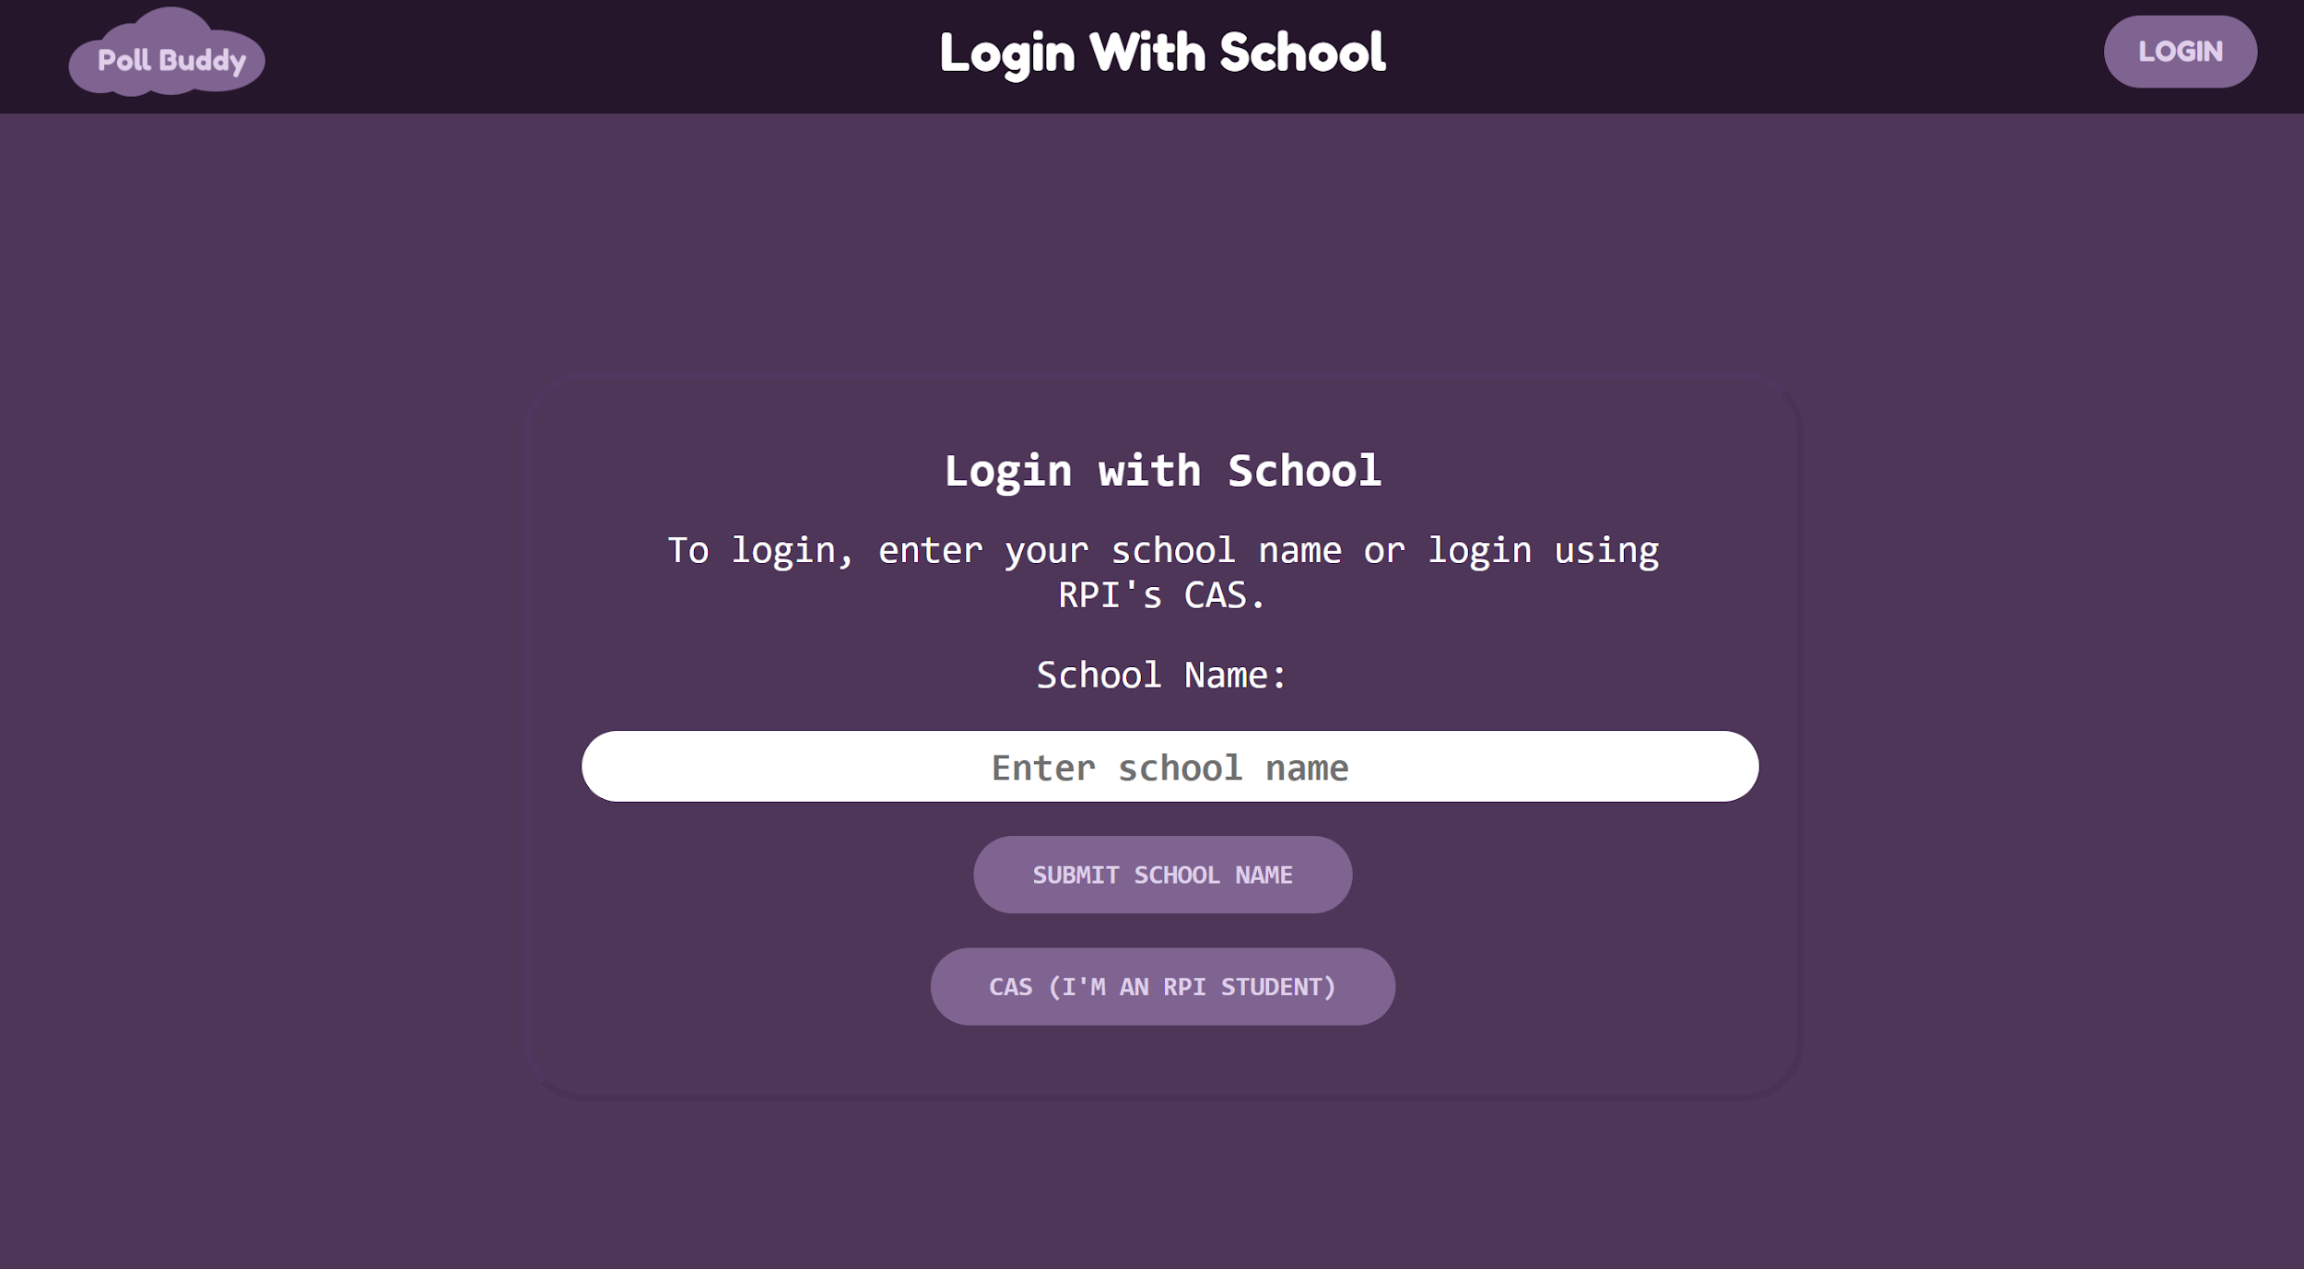
Other Pages
Notes:
Presenter: Neha
Other pages - Throughout the rest of the semester, I continued working on the front end of various other pages that we need on the Poll Buddy website. You can see those pages on the slide here. The pages are Answer Recorded, Instructor Live Statistics, Instructor Polls, Question Ended, and Login with School.

Slide 11
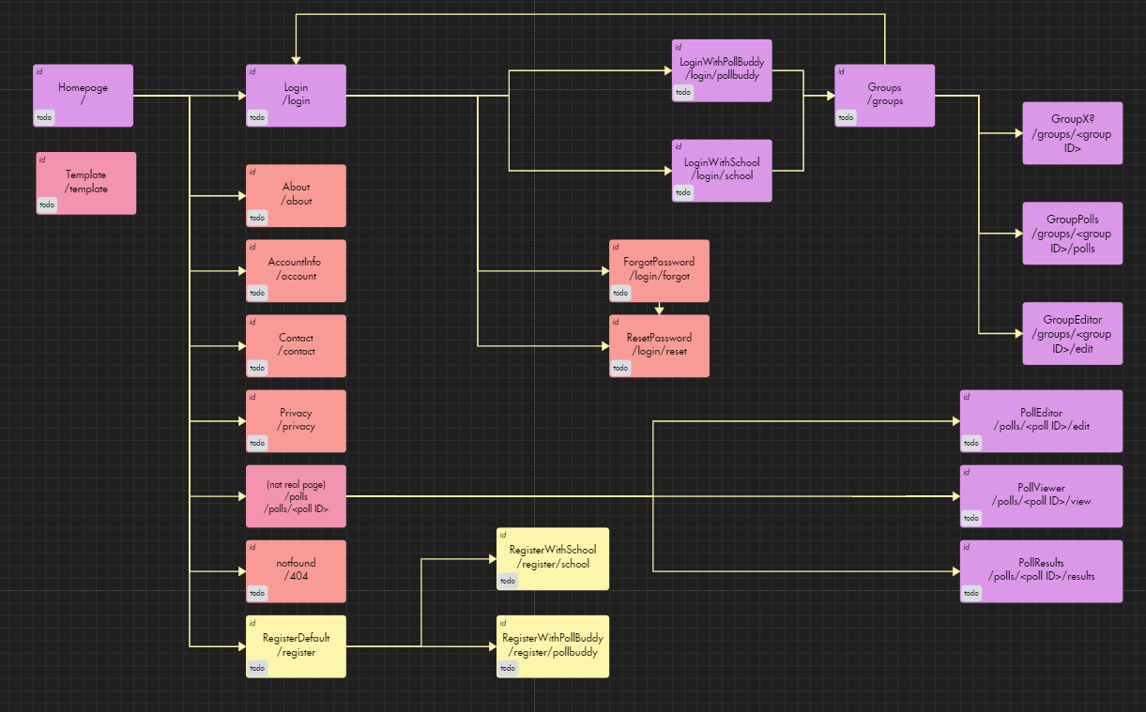
Site Map
Notes:
Presenter: Shweta
Hi my name is Shweta and this summer I worked on the site map for Poll Buddy. I made this diagram to show the user flow through the website, so it is easy to understand how each page connects to the other. I also updated the URLs to show the hierarchy of the pages, so for example the login with school page’s url is /login/school instead of /loginwithschool. I also went through and updated the code to reflect these changes.

Slide 12
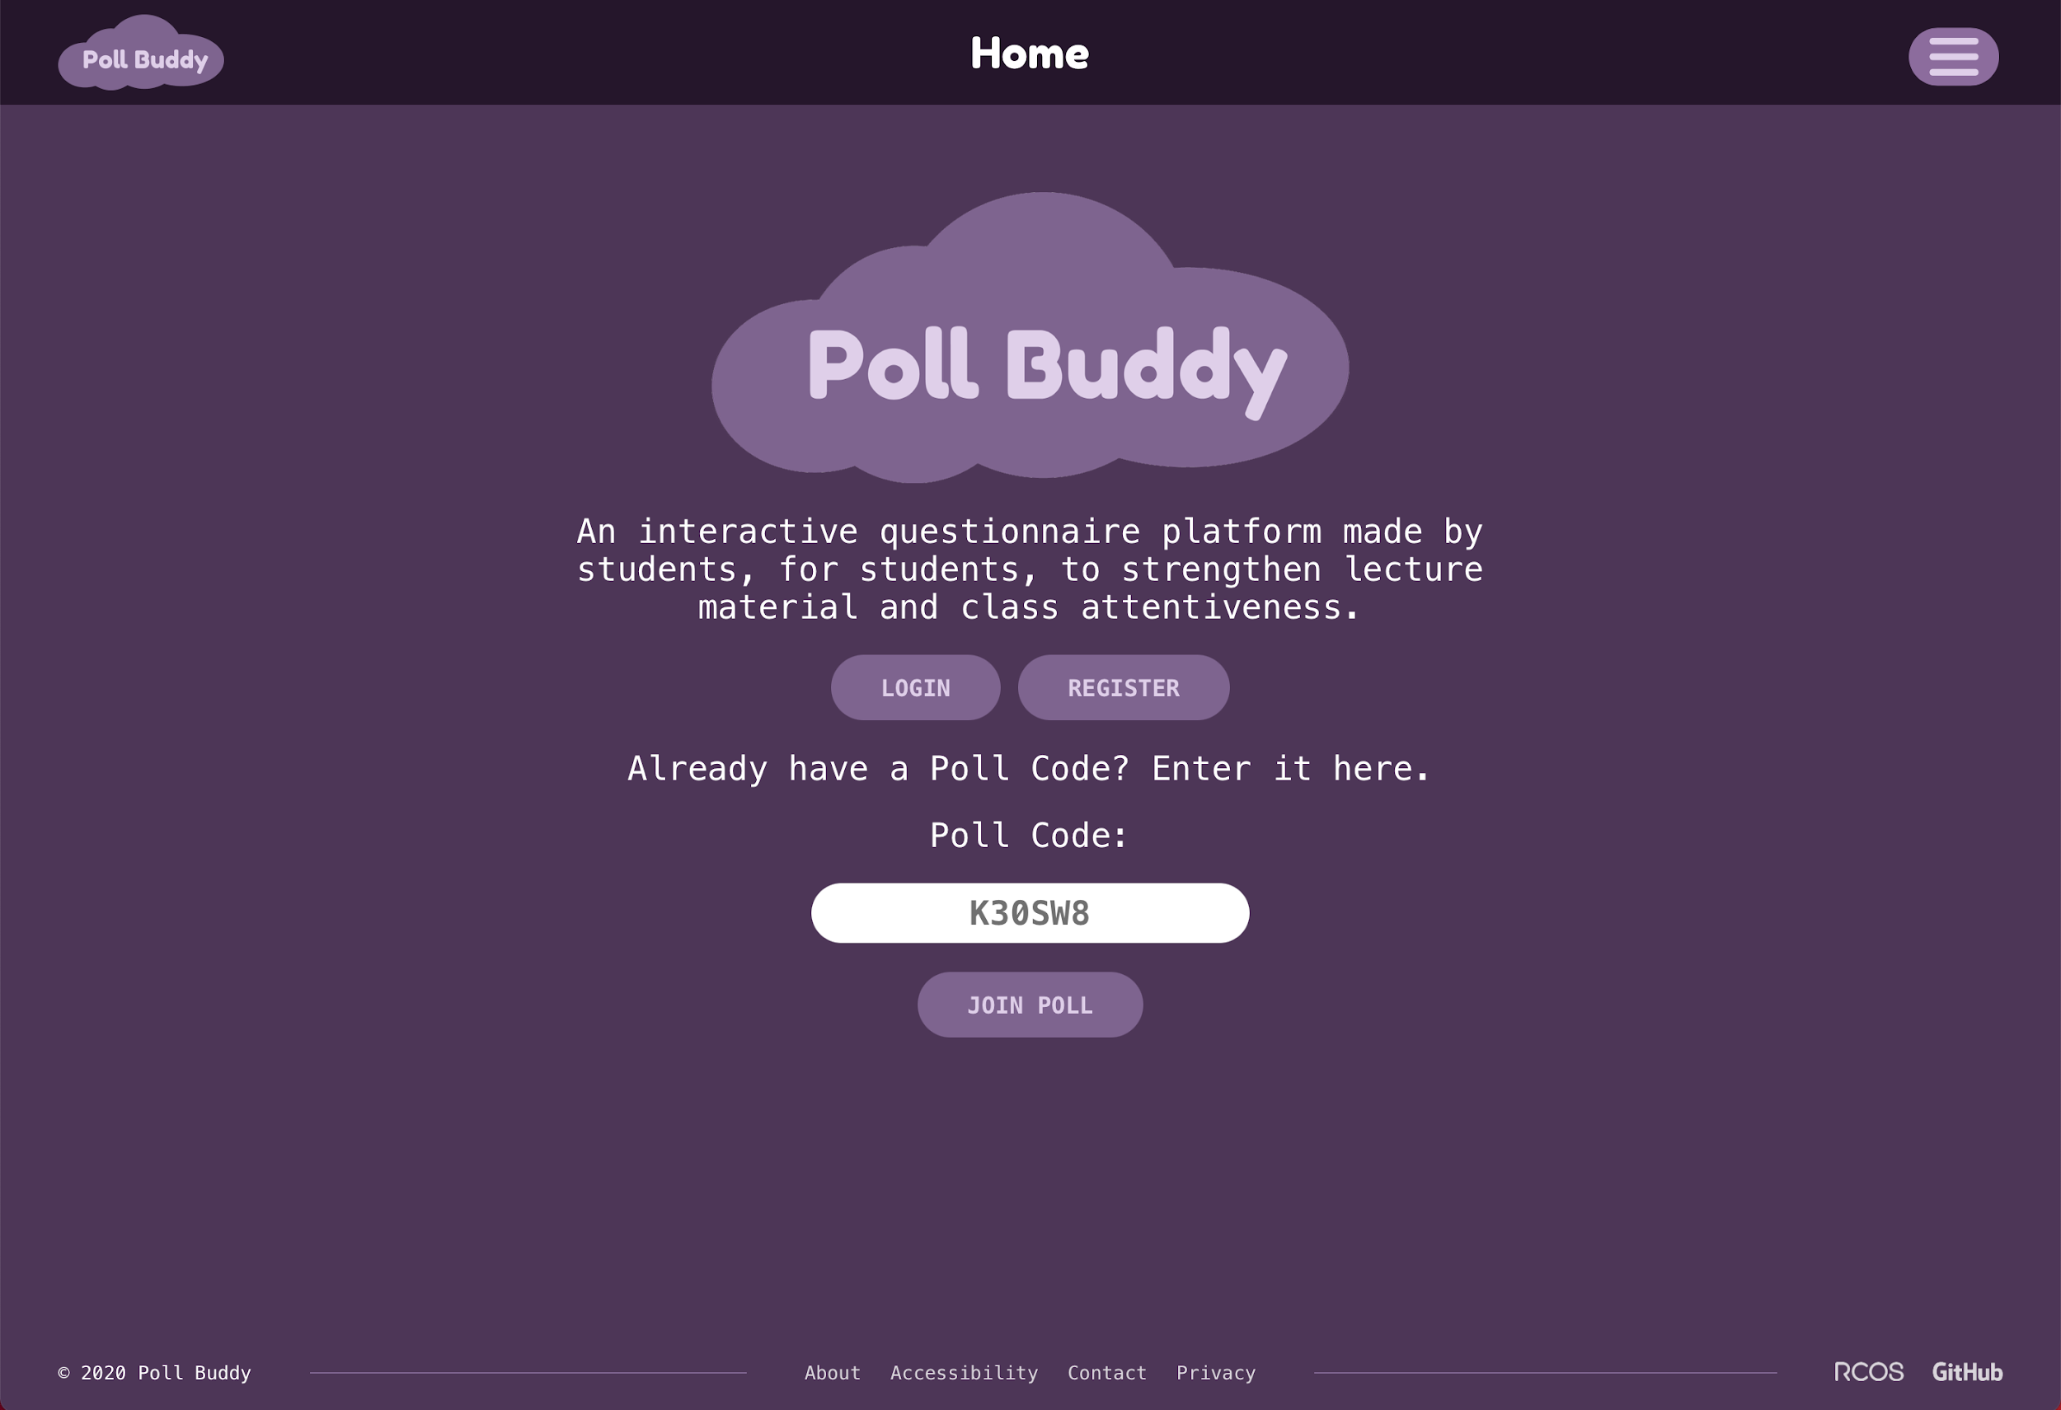
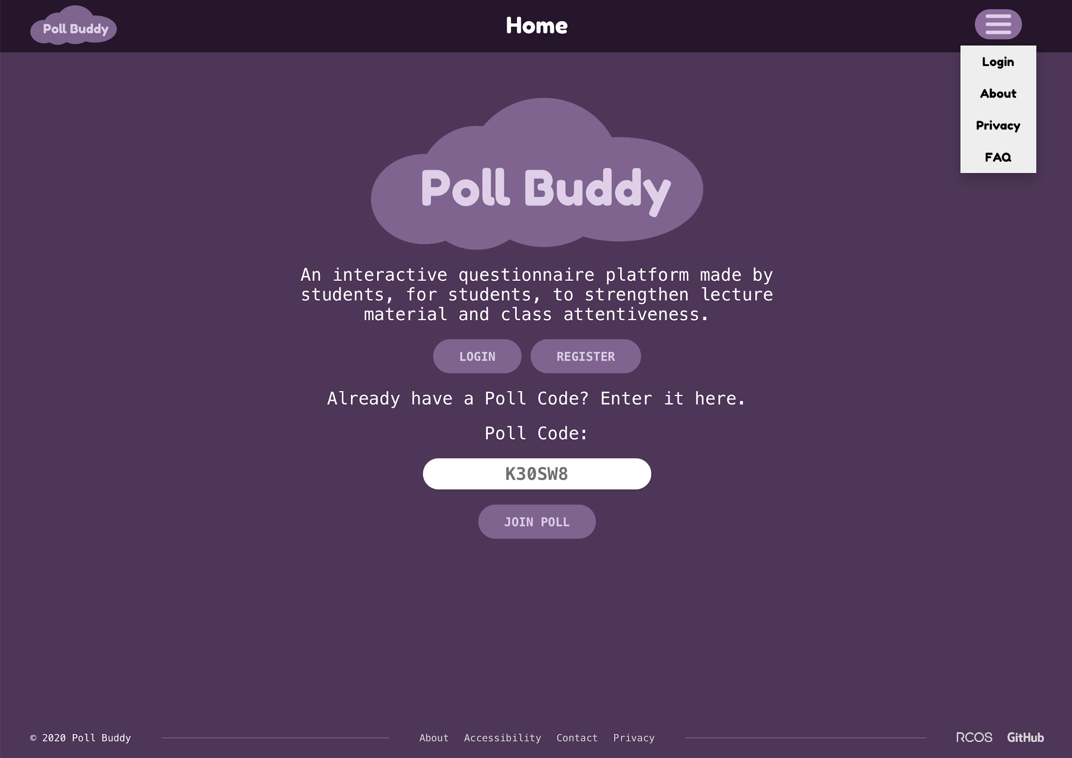
Header dropdown menu
Notes:
Presenter: Andrew E

Slide 13
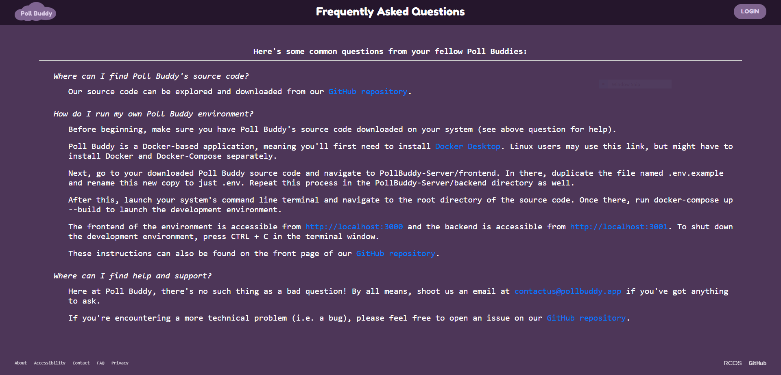
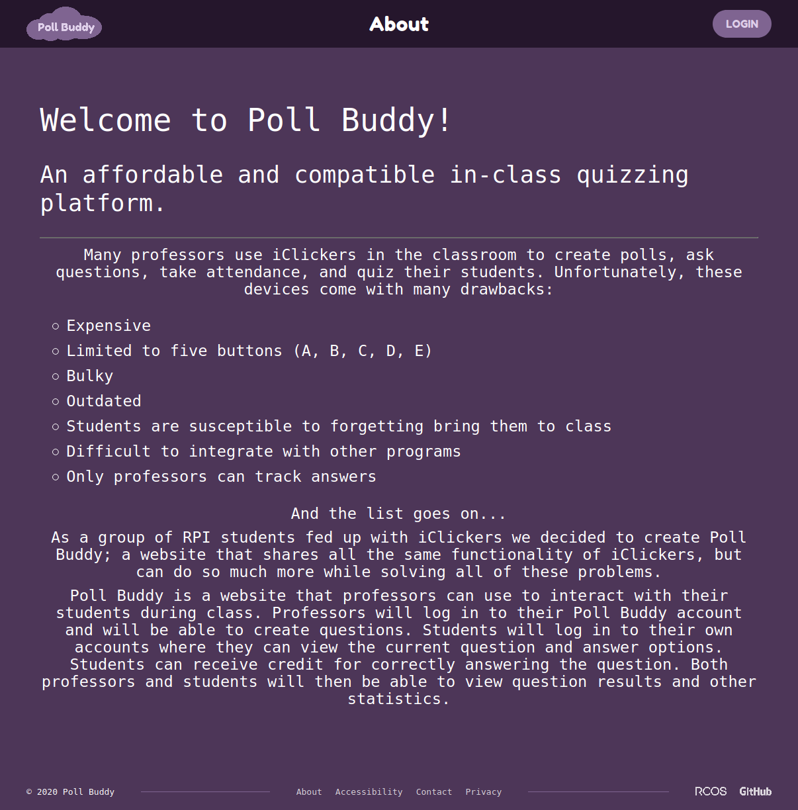
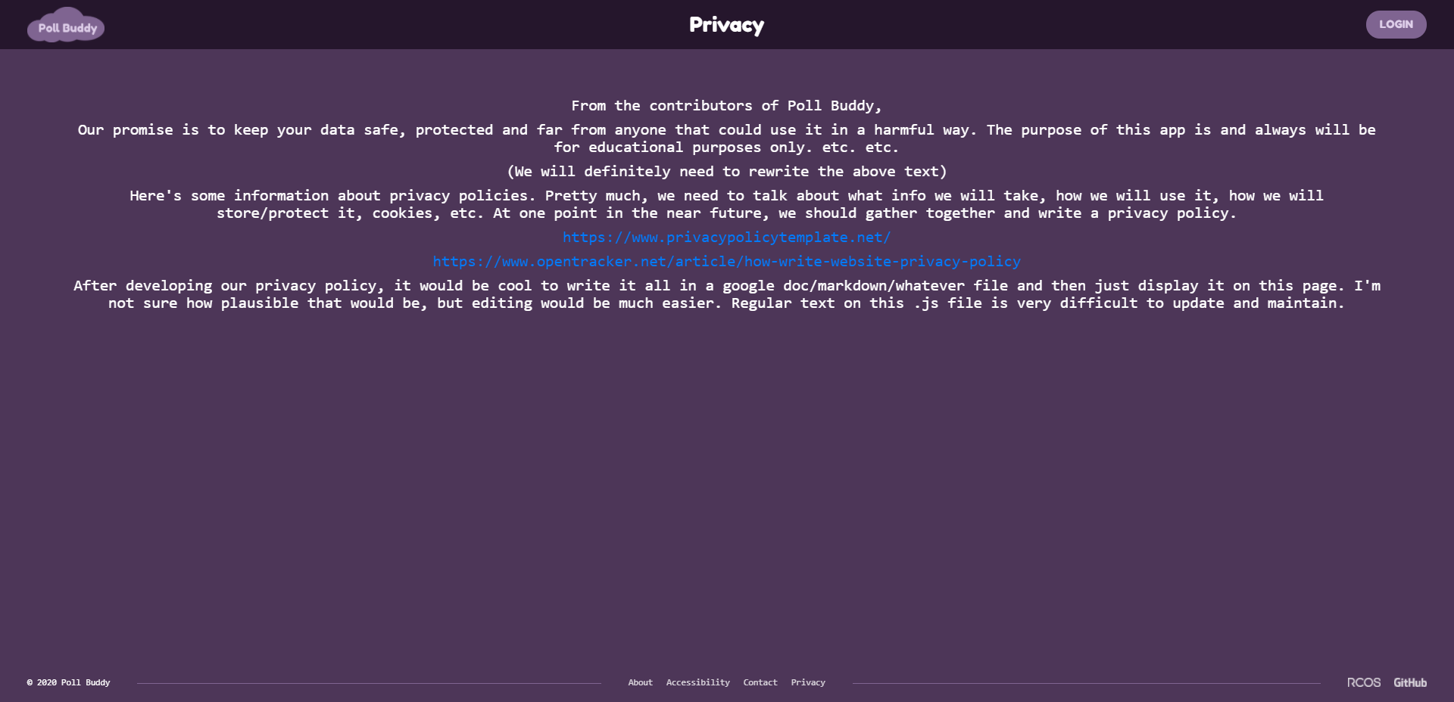
Markdown-Based Footer Pages
Notes:
Slide made by Sam, but I can present this one with the other page creators, will discuss
Andrew will present markdown / about, Sam will present FAQ page

Slide 14
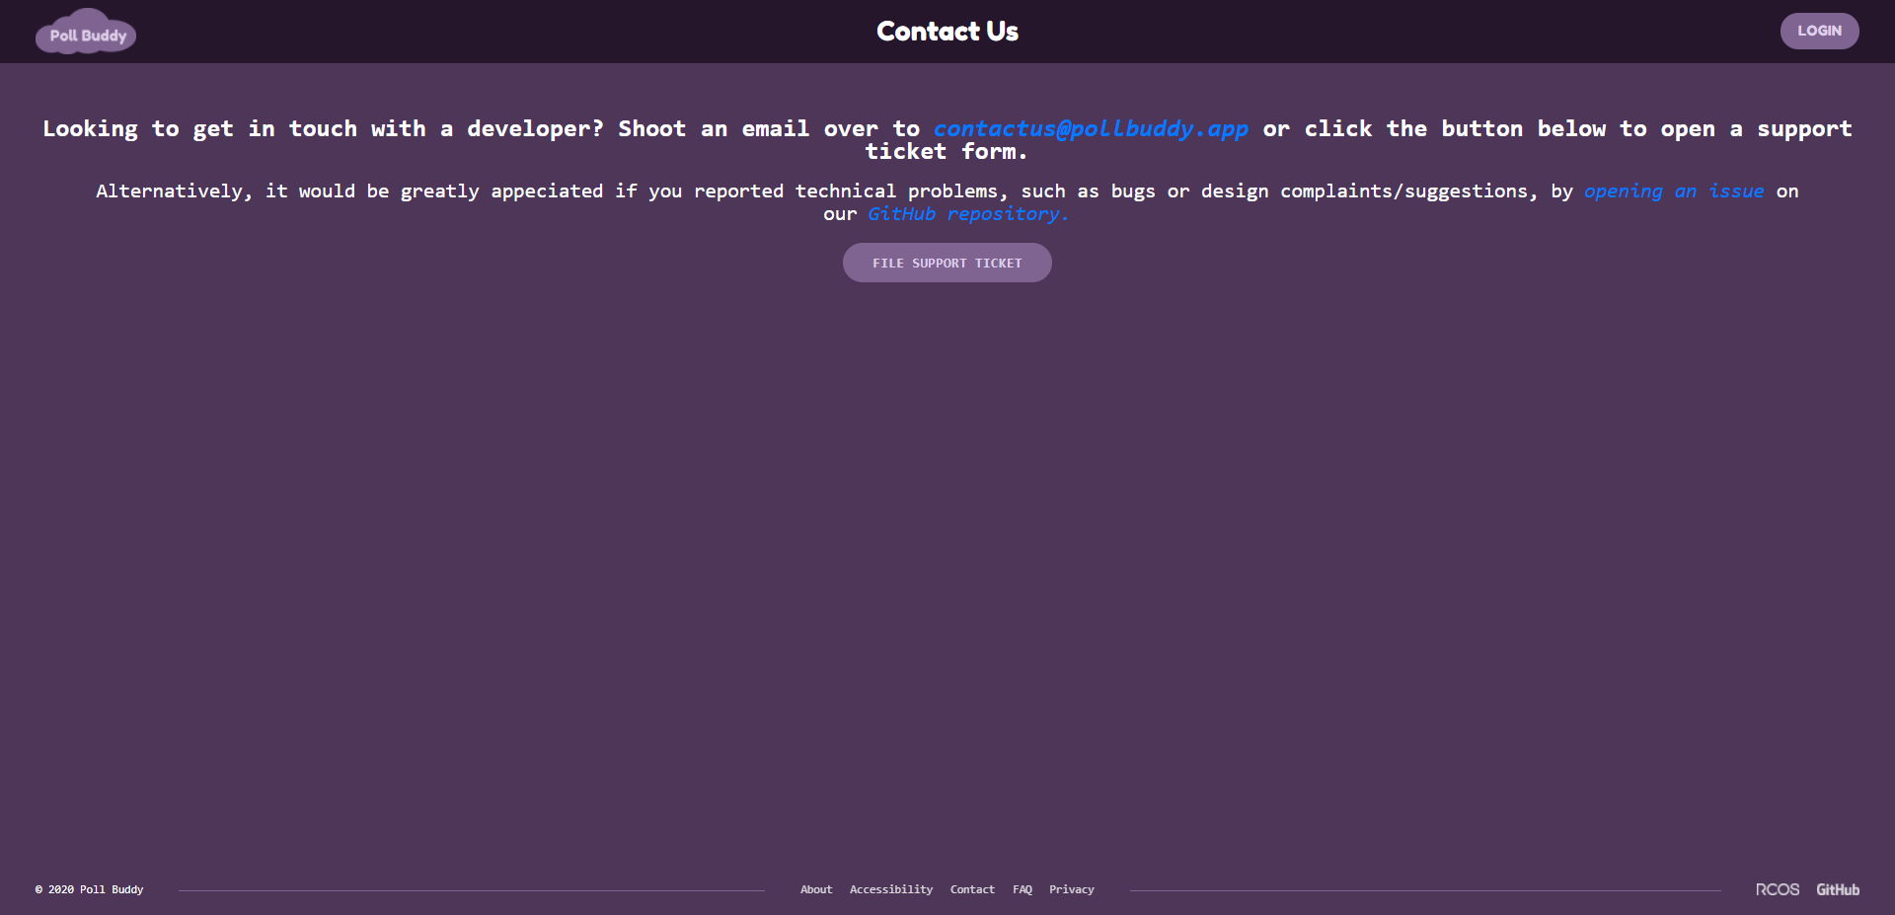
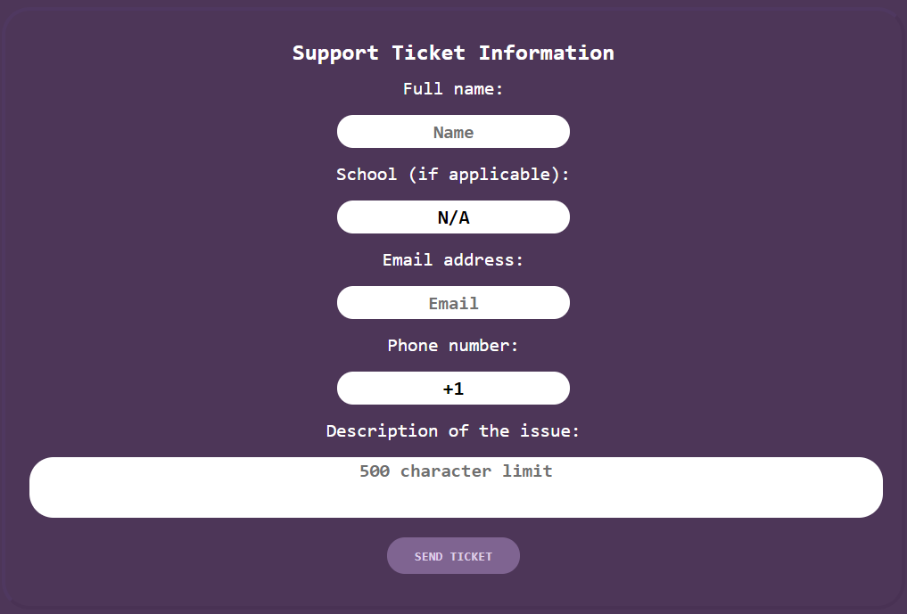
Contact Info Page
Provides links to email and GitHub
Can file a support ticket right from the page
Expands / Collapses
“Smart” form fields
Notes:
Presenter: Sam
This summer, I decided to enhance user experience by having “contact” in the site’s running footer link to a separate page instead of being just a direct email link. On here, I kept the original email link, but also added links to our GitHub repository - one to the homepage and one to open an issue. I figured that down the line, encouraging “power users” to go to GitHub would separate support concerns between technical and non-technical nicely. Also, as you can see, there is a support ticket form on the page too. It’s initially hidden to avoid information overload, but clicking the button will show the form and clicking “send ticket” will hide it again. Also, some of the inputs in this form are linked to React packages for a better experience filling it out. These include suggested autocomplete in the school field to avoid having to type out a full name, a phone number field that auto-formats the number, and a textarea for the issue description that automatically resizes as you type in it.

Slide 15
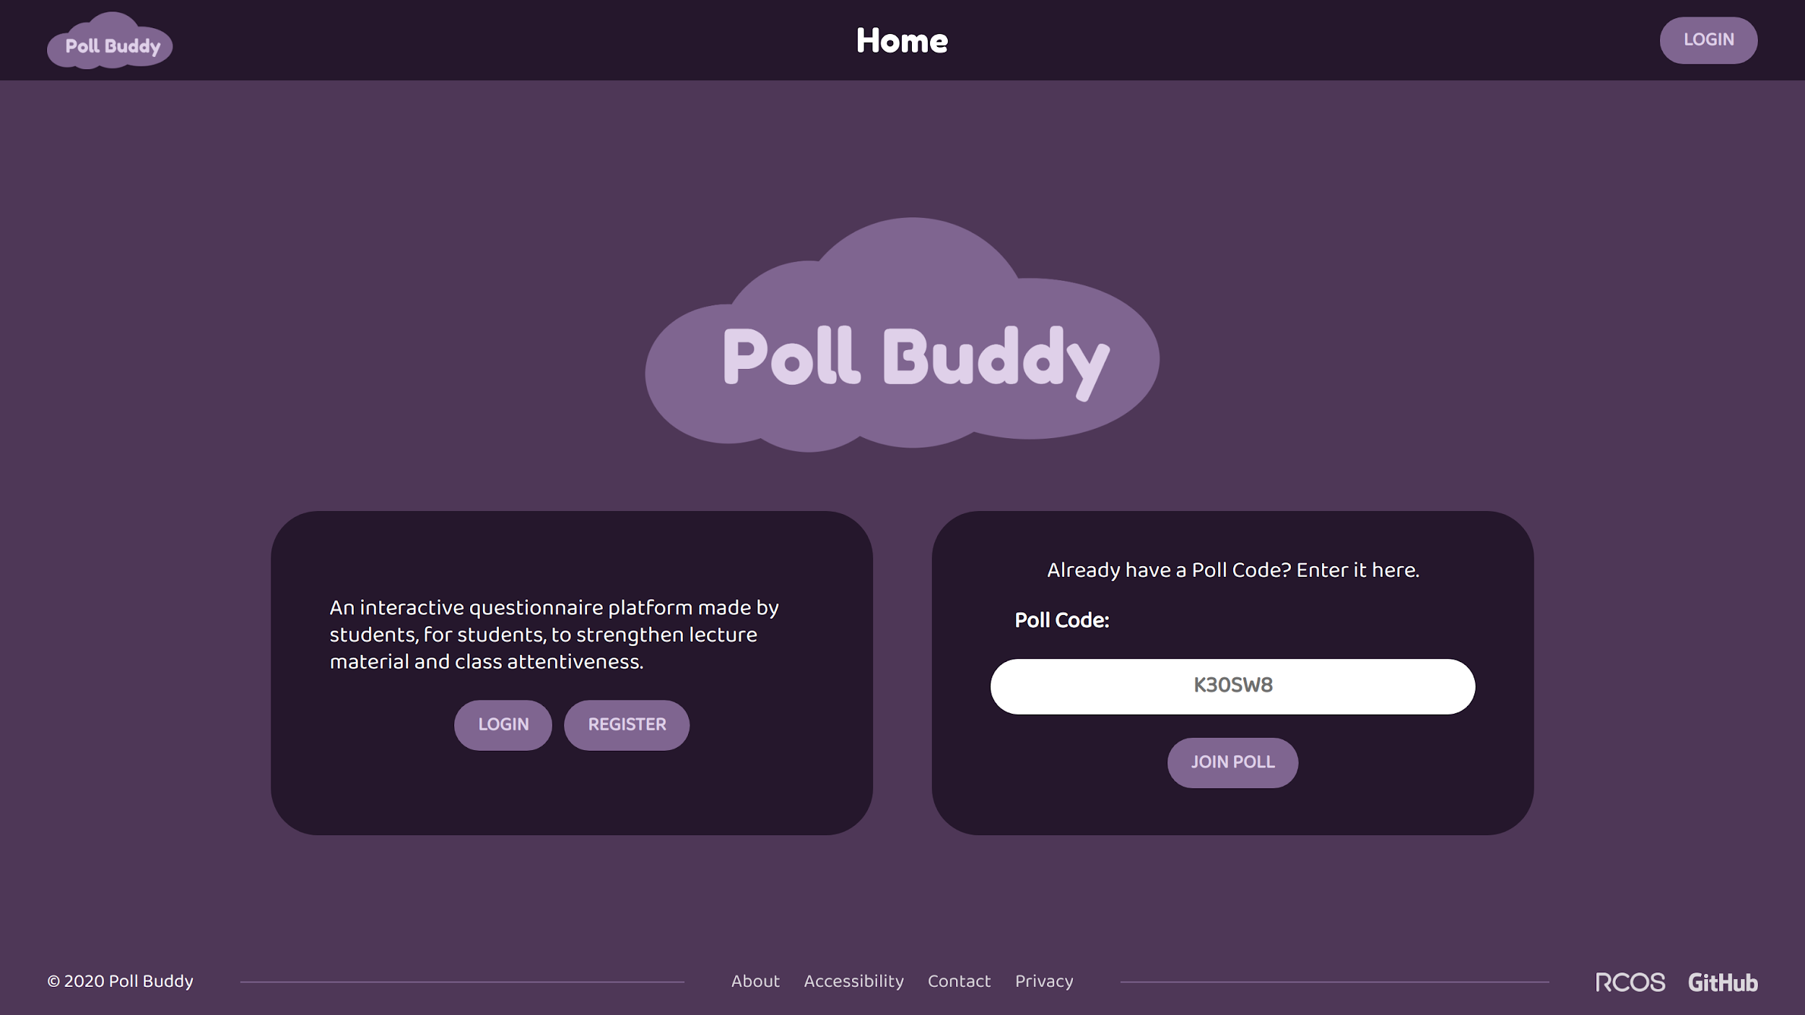
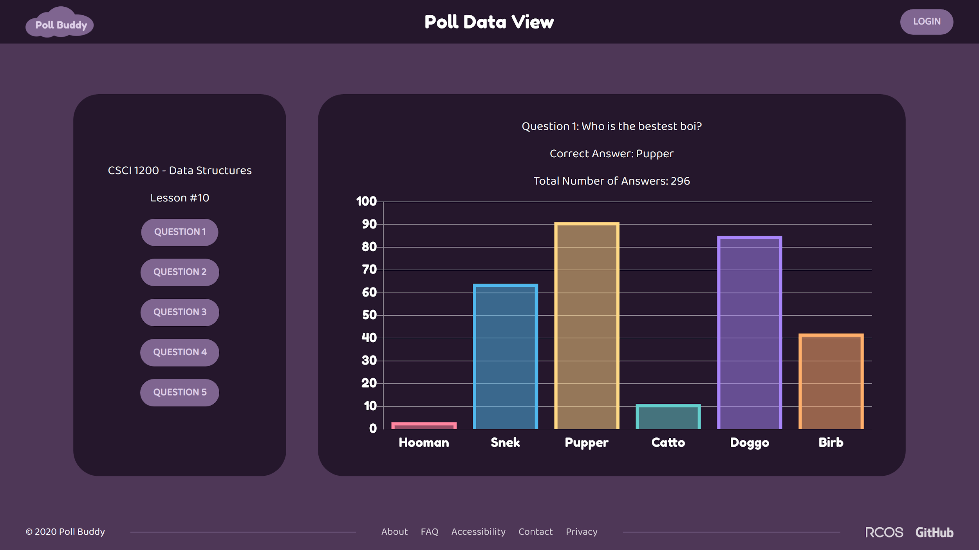
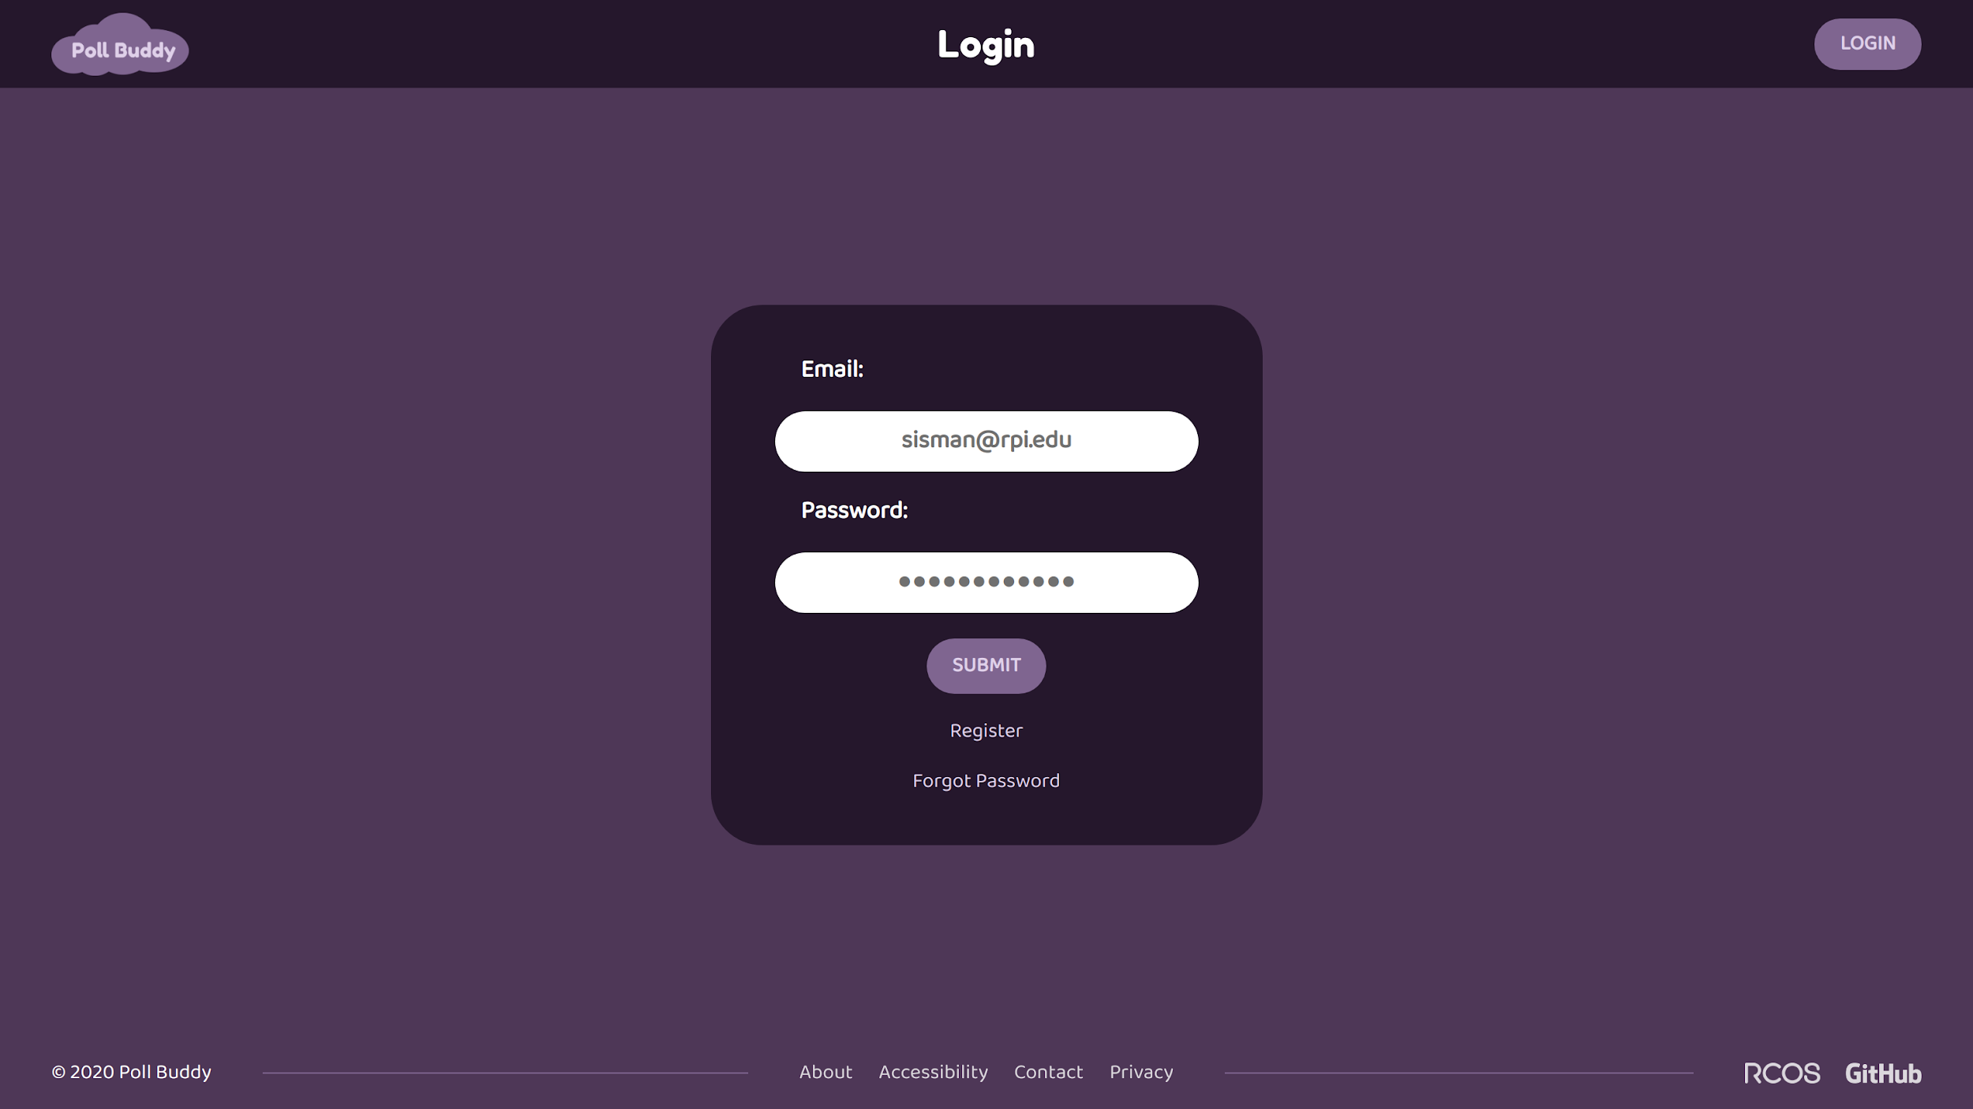
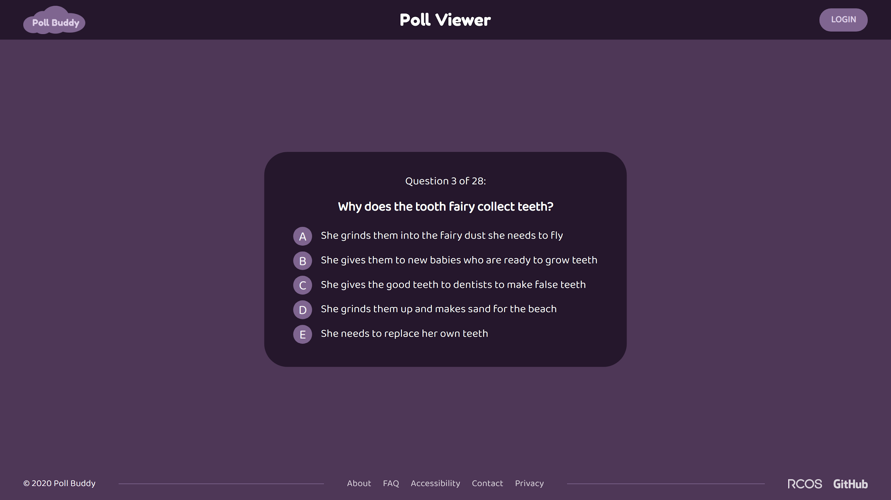
New Theme/Design
Notes:
Presenter: Annie
After the css unification, I worked on unifying the look of the site. Previously, we had some elements that were flat and some that were not / had shadows. We decided to use a flat web design, as it’s more modern. I wrote the styling for the theme and implemented it across all existing pages. With this theme update, I also updated the body font.

Slide 16
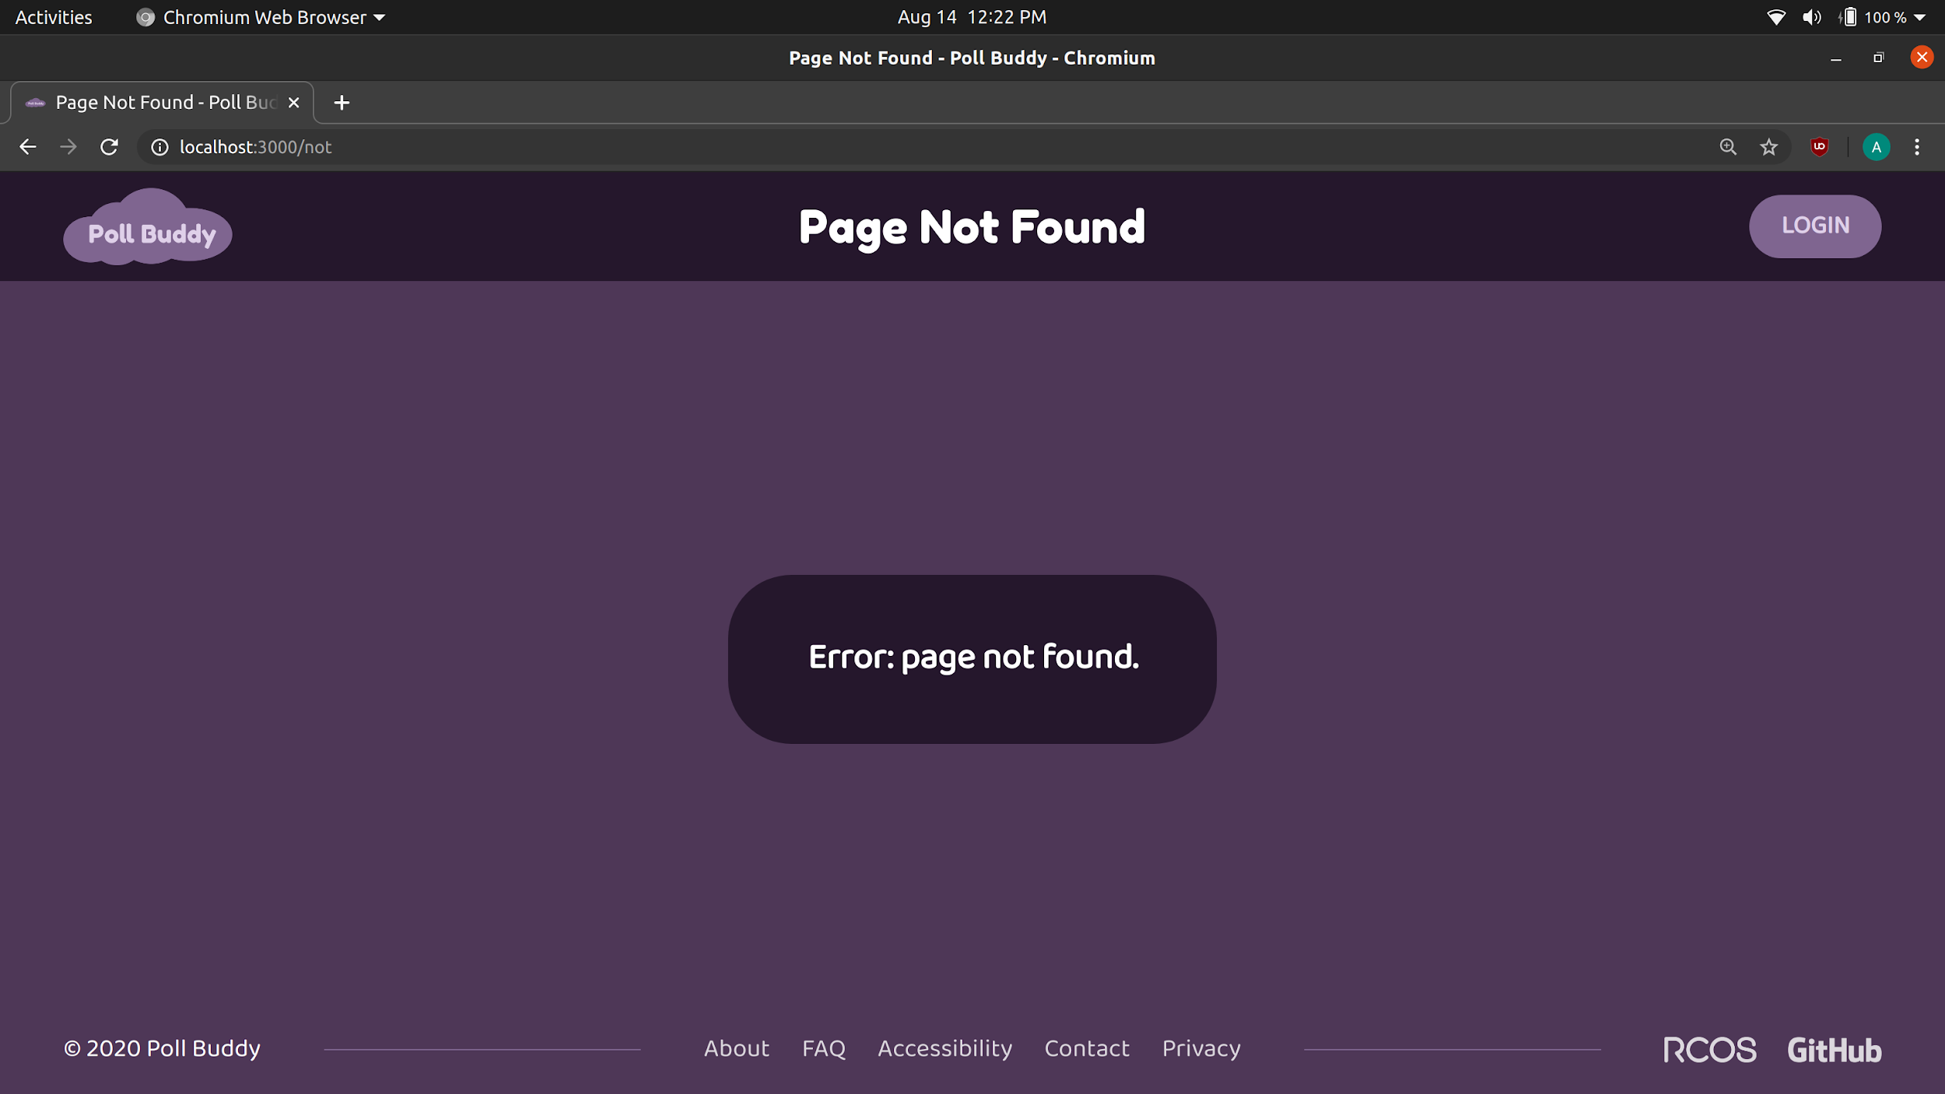
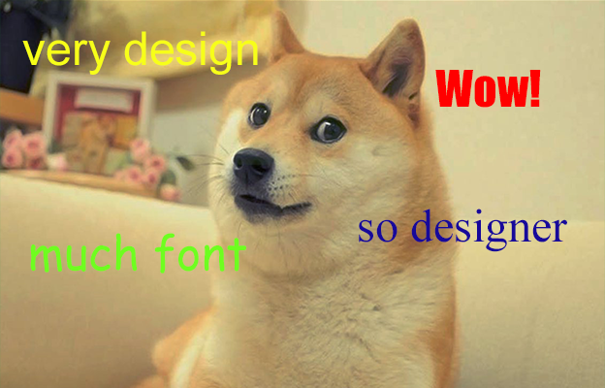

Additional Features
Updated footer
New styling for input fields on focus
Notes:
Presenter: Annie
I modified the design of the footer to include our name, and also updated the links to include some of the new pages. I also worked on styling for input fields, as to make it more indicative that you’ve clicked on it and may be entering information.

Slide 17
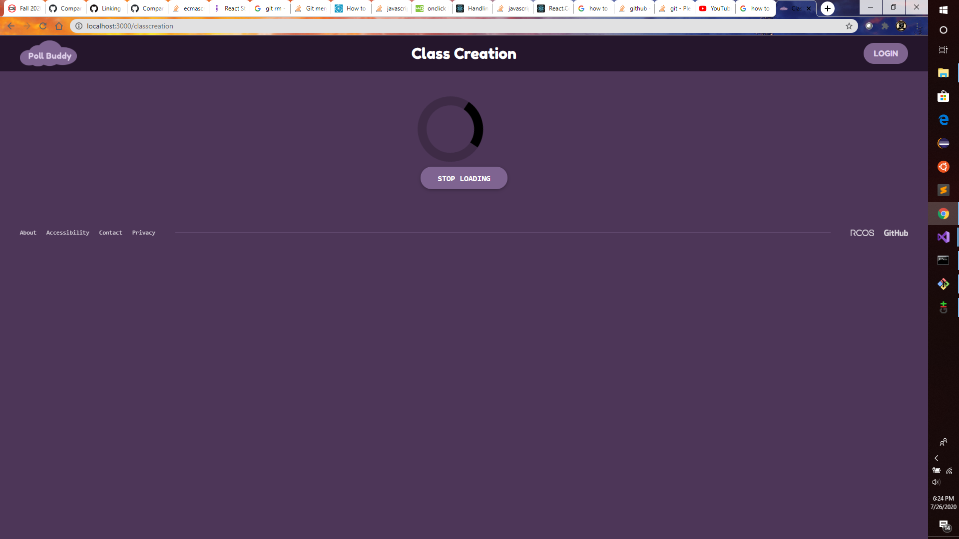
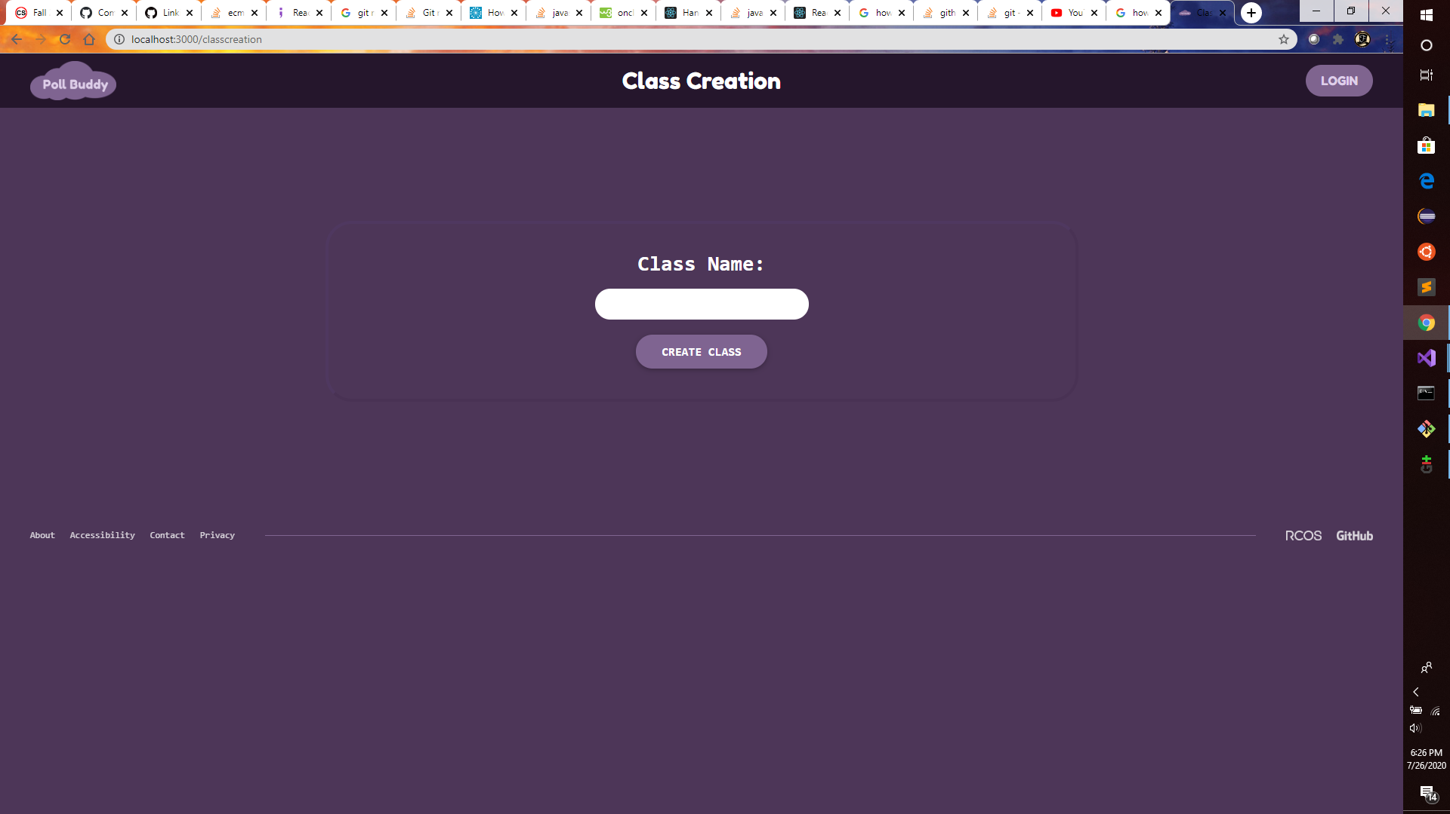
Loading Wheel Component
Added Loading Wheel Component
Implemented on Class Creation Page
Notes:
Presenter: Andrew Fang
I worked on adding a loading wheel component to be used whenever a page is waiting for data. I also implemented the component on the class creation page in order to test it. I tested to ensure that the loading wheel would show up and to ensure that it would be possible to stop the loading wheel but still need to test to see if the loading wheel stop will trigger at the right time which is currently impossible.

Slide 18
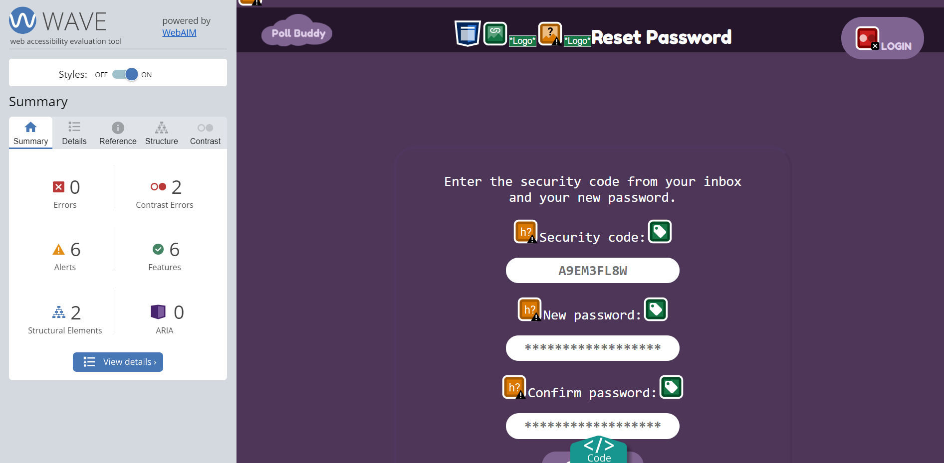
Accessibility
Notes:
Presenter: Jason Pu

Slide 19

Back End
Notes:
Presenter: Shweta
Hi I’m Shweta again and I’m going to talk about the backend a bit now.

Slide 20




Backend Technologies
Docker
NodeJS
Express
MongoDB
Notes:
Presenter: Shweta
We’ve talked about this before in the previous semesters so I’ll just give a brief overview. The backend technologies we are using are Docker, NodeJS, Express, and MongoDB.
Each part of Poll Buddy runs in its own Docker container running either NodeJS or MongoDB. Within Node.js we’re using the Express framework to make development easier, which then talks to the Mongo database to store long term data.

Slide 21
Frontend-Backend Interaction
frontend
get
Database
fetch
Backend
post
Notes:
Presenter: Shweta
Frontend-backend integration consists of various API URLs made in the backend that the frontend can then call to retrieve data. This helps with modularity and performance, as well as ease of development.

Slide 22
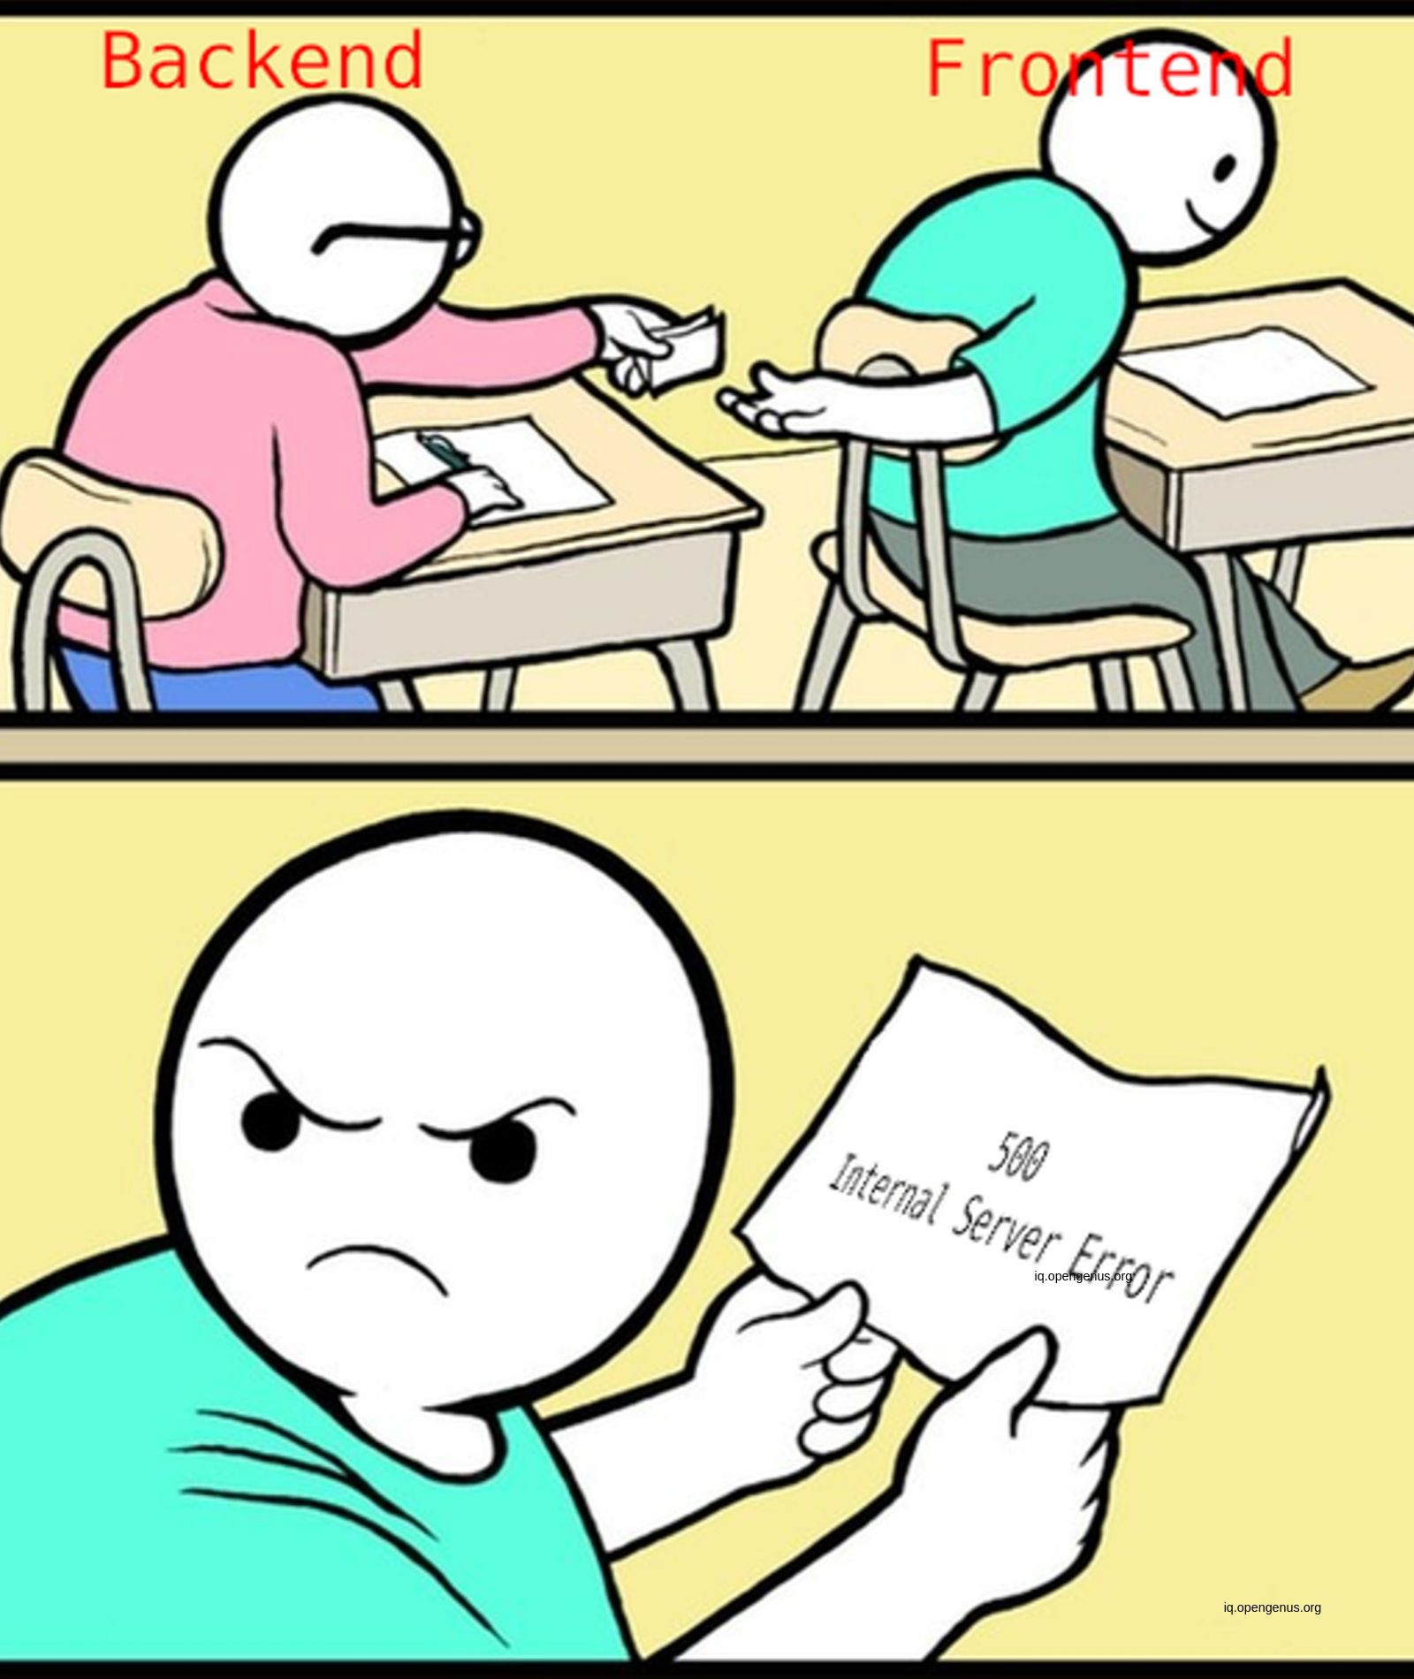
Backend Tasks
Further integration with frontend
Login functionality
CI/CD setup
Docker cleanups
Logging/Reporting containers
Notes:
Presenter: Shweta
Some of the goals this semester were to further the integration with frontend, build login functionality, set up CI/CD, perform Docker cleanups, and create logging/reporting containers.

Slide 23
CI/CD
Each commit and PR gets its own live deployment
Powered by Github Actions
PollBuddy.app
Main site runs the exact code on Master, and updates when changes are merged to Master
dev.PollBuddy.app
Upcoming controller site for test instances
dev-<commit ID>.PollBuddy.app
Independent test instances useful during development and review processes
2 new repos to handle the code for these processes
Notes:
Presenter: Hunter
Hi again, I’m Hunter and I’ll be talking about the next few slides that I worked on, starting with CI/CD. CI/CD stands for Continuous Integration/Continuous Deployment. This is the concept that enables rapid testing and delivery of software. For us, I set up a system that automatically deploys code on the master branch to our main website at pollbuddy.app. For each development branch commit, a separate and completely isolated instance is spun up on our dev subdomain so that reviewers can easily check out new code for our pull request review process, and it helps the developer test to make sure their code works not only on their machine.

Slide 24
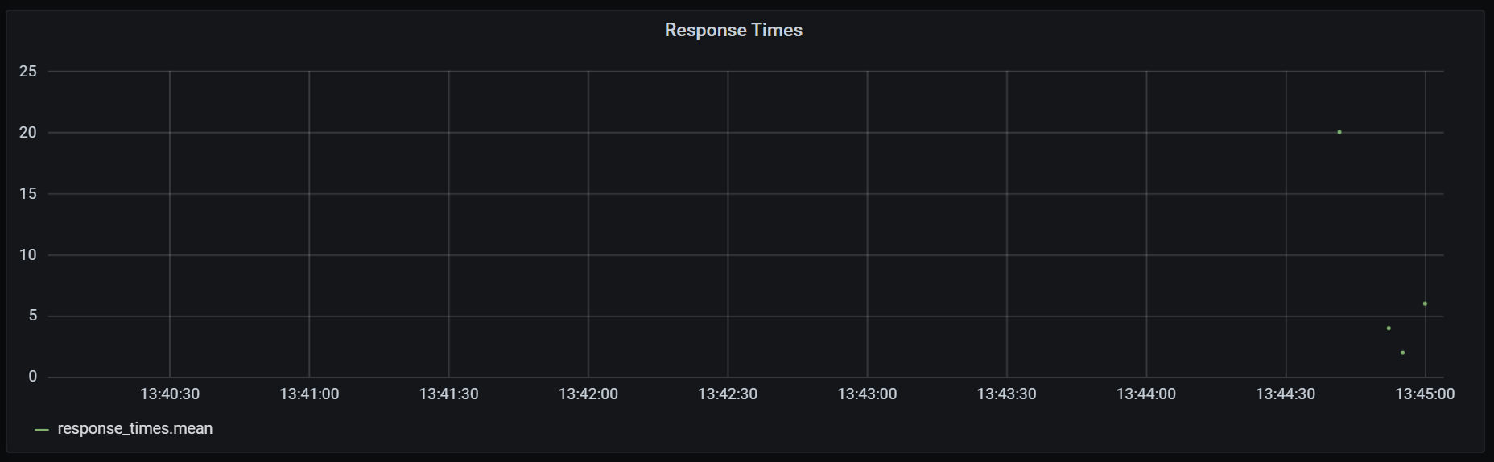
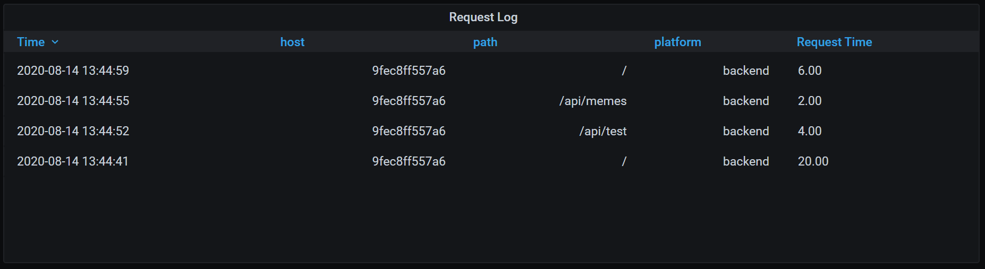
Logging and Reporting
Dedicated InfluxDB container to record events
Grafana container to display these events in a graphical way
Usage statistics
Slow calls
Analysis
Notes:
Presenter: Hunter
I also worked on some logging and reporting containers. These run InfluxDB and Grafana to record and display events that occur on the site. This isn’t fully finished yet but the aim is that it’ll log requests to see what URLs are hit most frequently, and what backend calls take the longest to run so we know where to focus our optimization efforts when we’re working to make sure we can handle the massive loads expected.

Slide 25
Docker Changes
Docker networks
Performance improvements
Faster compile/run times
Webproxy container
/* - frontend
/api/* - backend
/reporting/* - reporting
Security improvements
All requests run through webproxy
Protects from direct DB access, etc.
Notes:
Presenter: Hunter
Finally, I also made a bunch of changes to our Docker setup. As always, there’s more to do as I’d also like to have separate development/production configurations, but for now, I’ve set up Docker networks for better segmentation of services, added various performance improvements to speed up build and runtimes, and added a webproxy container to handle routing requests to the 3 different web-based systems we now have.

Slide 26
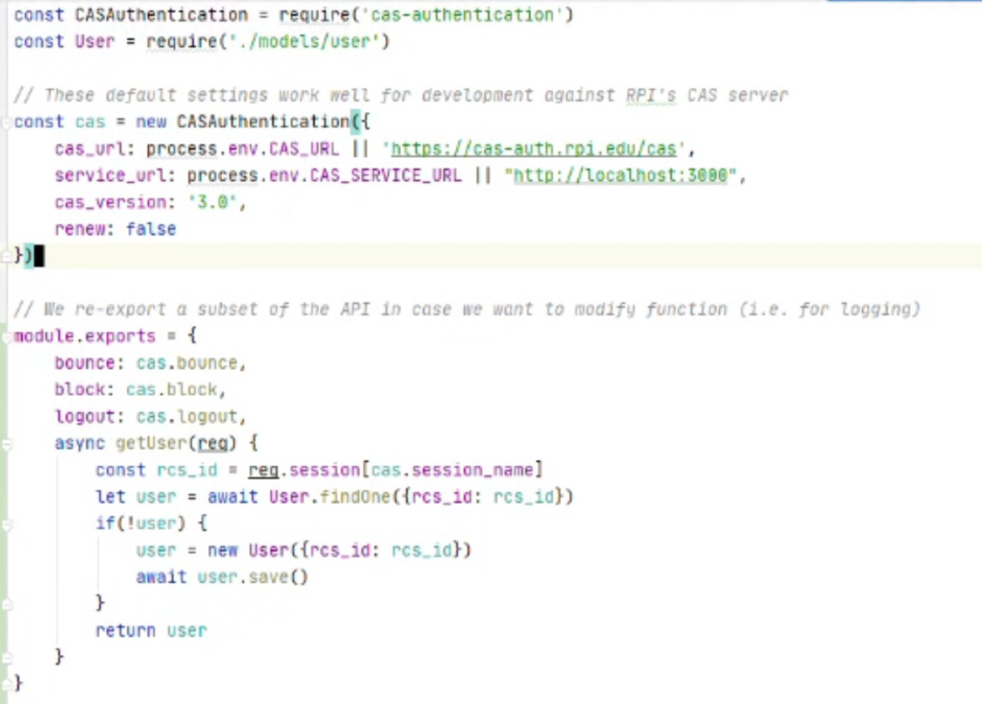
CAS Integration
Added CAS authentication for Login
Still need frontend-backend communication to utilize.
Notes:
Presenter: Andrew F
We began implementing CAS authentication with the RPI CAS in addition to the normal login. After some research we were able to make code that allowed our program to act as a CAS client but we still need the ability for frontend to be able to use the authentication.

Slide 27
Back End Future Goals
Further frontend integration
Further logging/reporting capabilities and graphs
Scaling
Submitty integration
Anti-cheating
And much more!
Notes:
Presenter: Shweta
Here are some of our future goals. First off, we need to finish the frontend/backend integration that is still lacking in many areas. Next is further logging and reporting, then scaling, then submitty integration, anti-cheat functionality, and much more.

Slide 28

Thank You!
Any Questions?
Notes:
Presenter: Hunter
This has been Poll Buddy! Does anyone have any questions?

